Slide 1
Equity Market Outlook:
Navigating Global Equities in a New Regime
Gina Martin Adams, CFA, CMT
Chief Equity Strategist
Bloomberg Intelligence

Slide 3
2025: Fading U.S. Exceptionalism
  * Models Point to Low U.S. Returns in 2025
  * Policy Points the Way
  * Earnings Cycle Favors ROW
  * U.S. Valuations Remain Elevated
  * Concentration Works Against U.S.
  * Portfolio Strategies Lean Non-Domestic

Slide 4
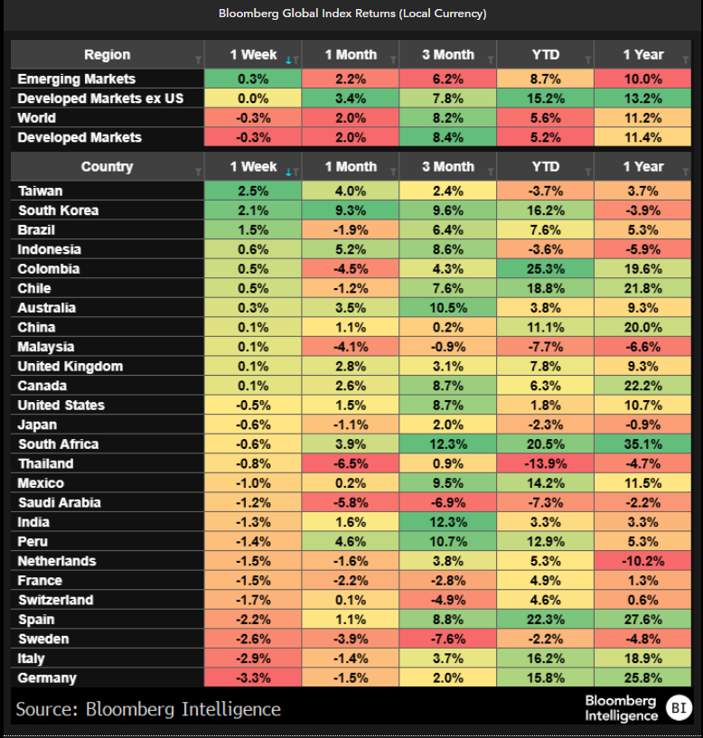
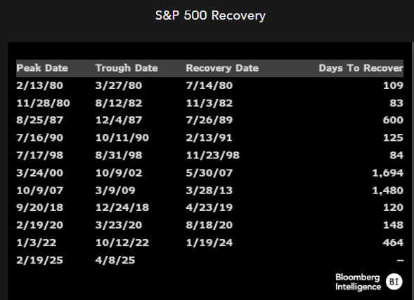
Even with Fastest Recovery in 50 Years, Returns Lean Ex-US

Slide 5
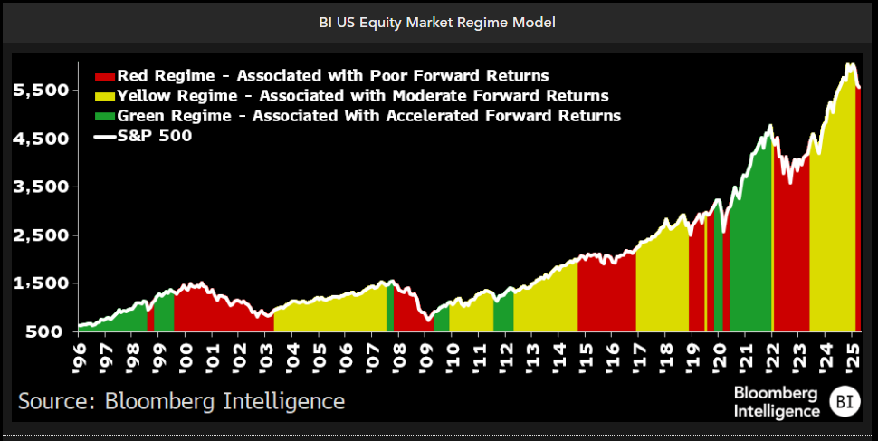
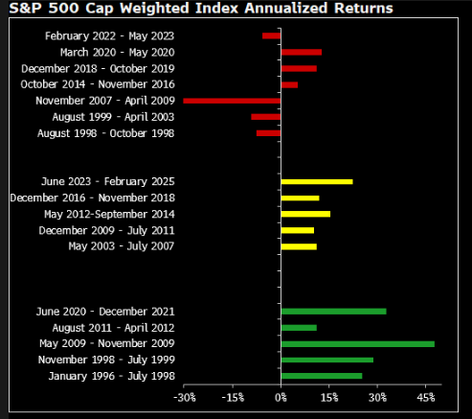
U.S. Market Regime Hit Red in 2025
Notes:
{NSN SUEANADWLU68 <GO>}

Slide 6
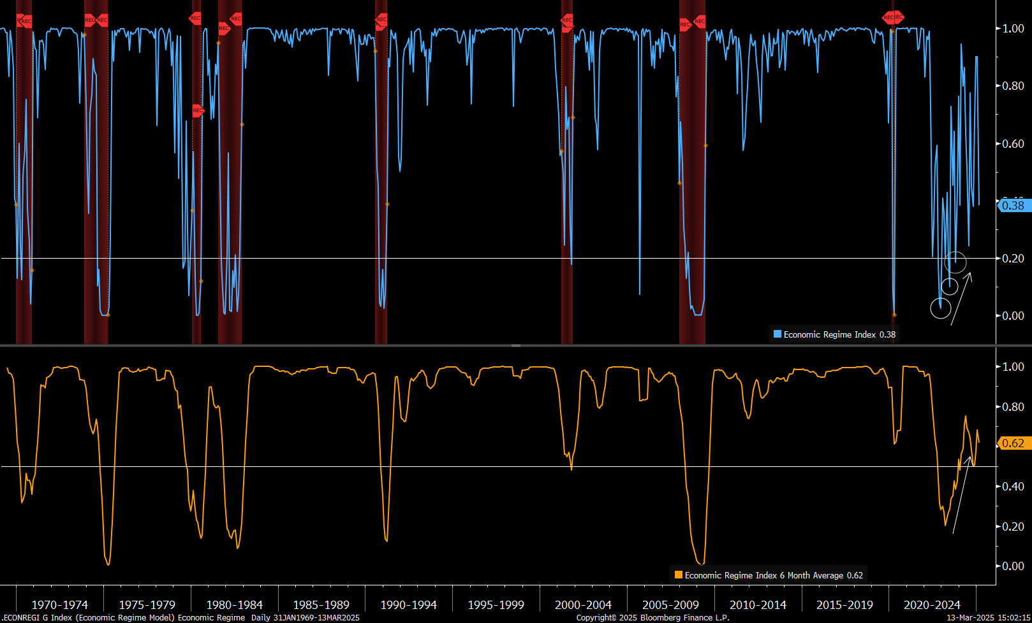
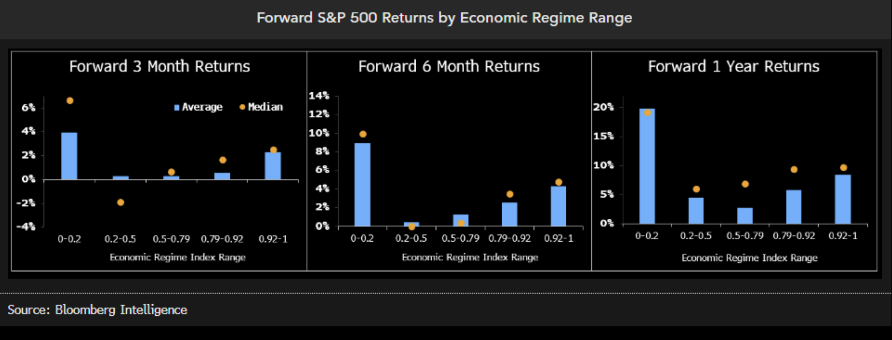
Economic Regime Model Says to Expect Little
* Source: Bloomberg Intelligence
Notes:
{BPRV ID:229769 BITID:2493004 <GO>} – in for Monday

Slide 7
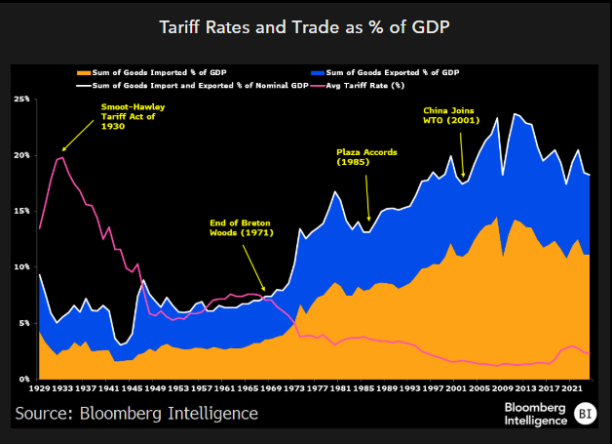
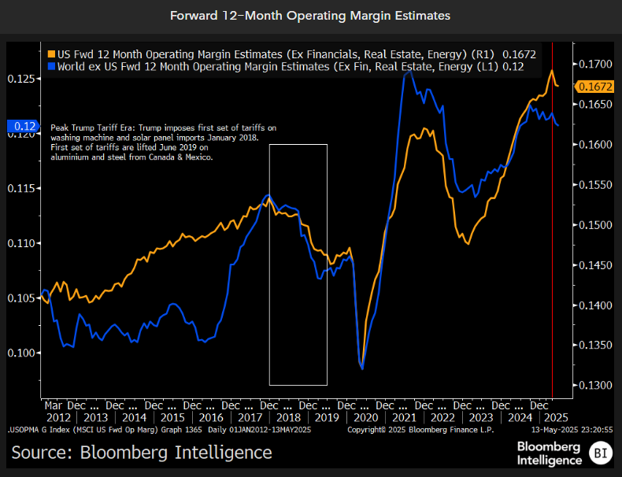
#1: Policy Dampens the Margin Outlook
Notes:
{NSN SGV9G6T1UM0W <GO>}
{NSN SM979ADWLU68 <GO>}

Slide 8
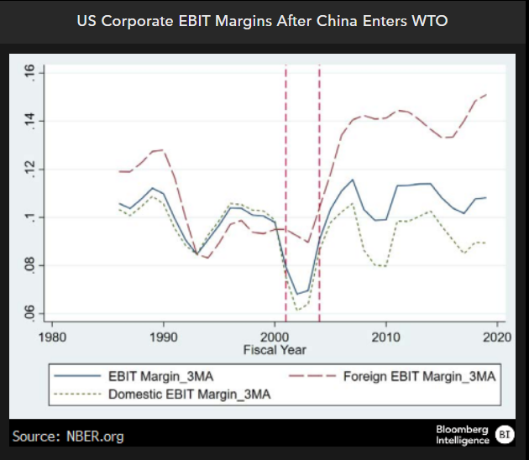
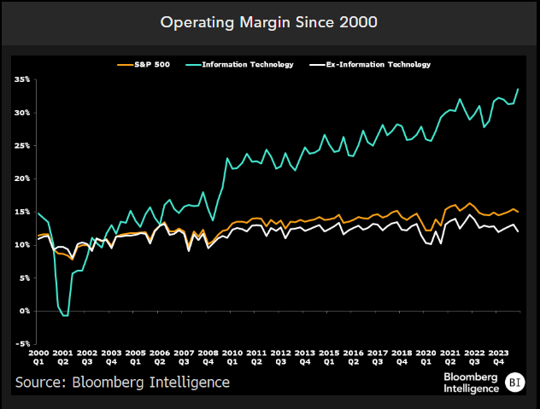
U.S. Margins Depend on Foreign Earnings, Tech
Notes:
{NSN SV7XBAT1UM0W <GO>}
Both there

Slide 9
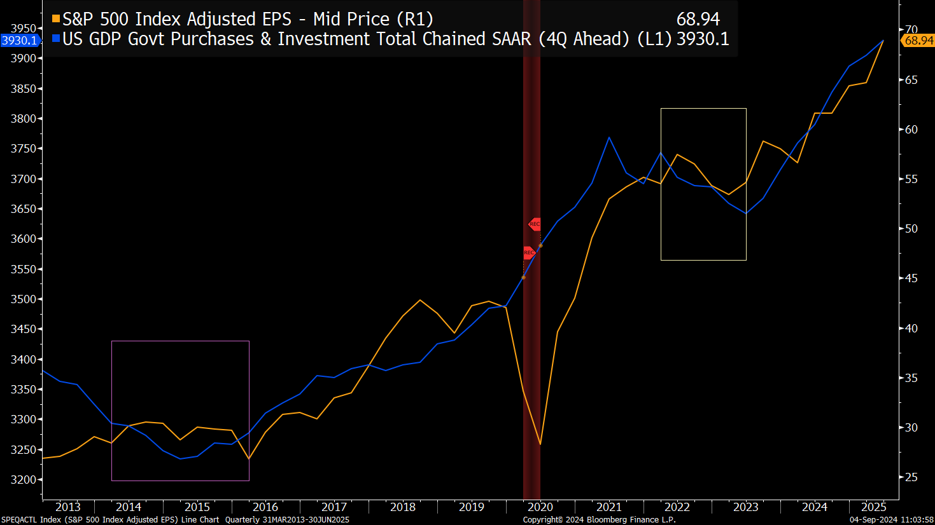
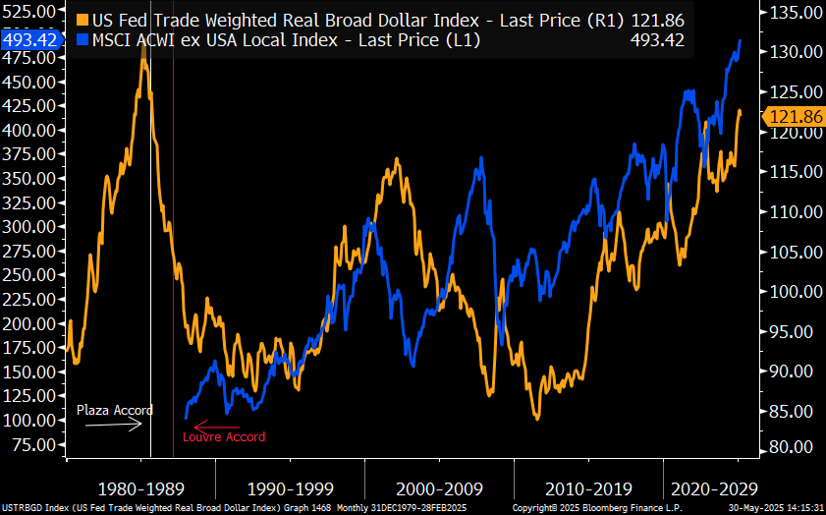
Policy a Support Outside the US
* Source: Bloomberg Intelligence
Notes:
{NSN SINKQ9DWRGG1 <GO>}
The National People's Congress meets in full session for roughly two weeks each year and votes on important pieces of legislation and personnel assignments, among other things.
China is running its highest official fiscal deficit ratio in over 30 years (budget deficit / GDP. The government is spending more money (infrastructure, military, R&D, etc.) than it earns (taxes) as a % of GDP)
Authorities have set an ambitious economic growth goal of about 5% for 2025 and brought China's fiscal deficit target to the highest in over three decades. However, if the trade war with the US intensifies, economists say China will need to roll out substantial stimulus to meet its growth target this year.
Government spending on defense and tech is targeted to rise this year. Tech and consumer discretionary have really carried the china rally so far this year. However over the past month, we have seen tech and discretionary start to cool off, but materials (which typically do well after the NPC budget meetings) pick up, along with staples.

Slide 10
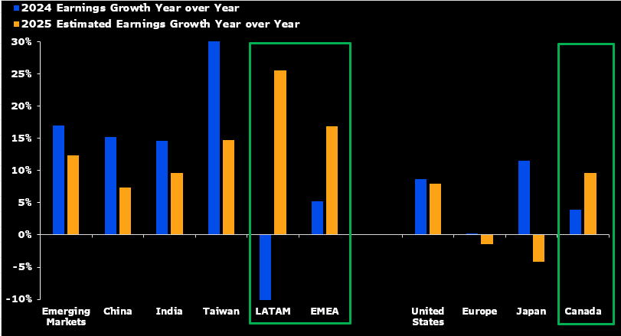
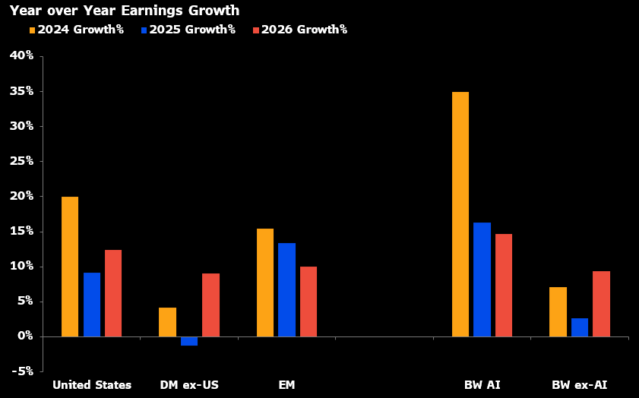
#2: US vs. ROW Earnings Cycle
The Earnings Outlook Supports Rotation
* Source: Bloomberg Intelligence
Notes:
{NSN SMS6QBT0AFB4 <GO>}
from forecast time series on BI STOXG: {BI STOXG INDEXEPS |1014-2-W-Data|W12||USD<GO>}
Biggest Canada impact is energy is returning to earnings expansion after delcinin in 2024. materials are poised to double their pace of earnings growth, from about 23% yoy in 2024 to 43% in 2025. Ex both commodity sectors there is still acceleration into 2025 from 2025, as most sectors are poised to do better.

Slide 11
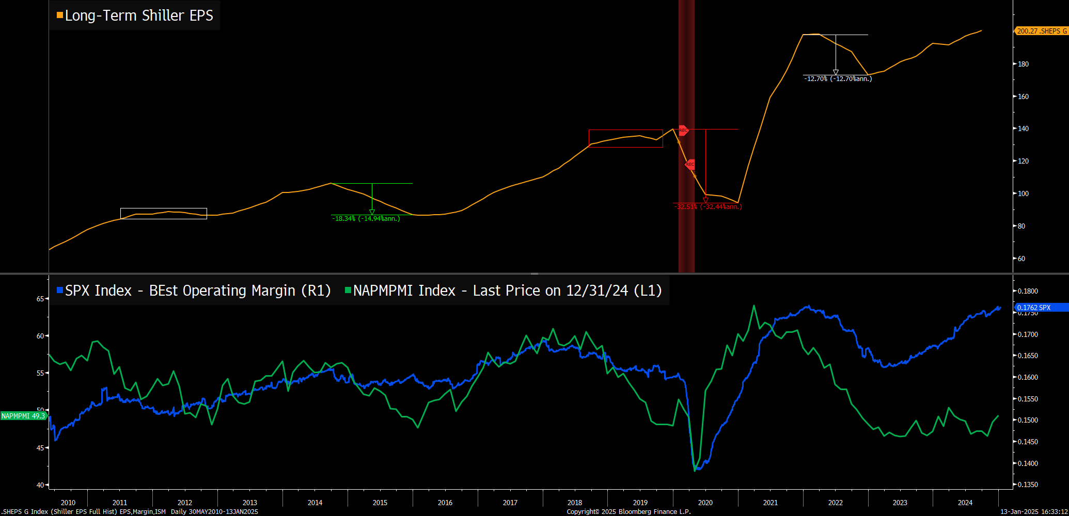
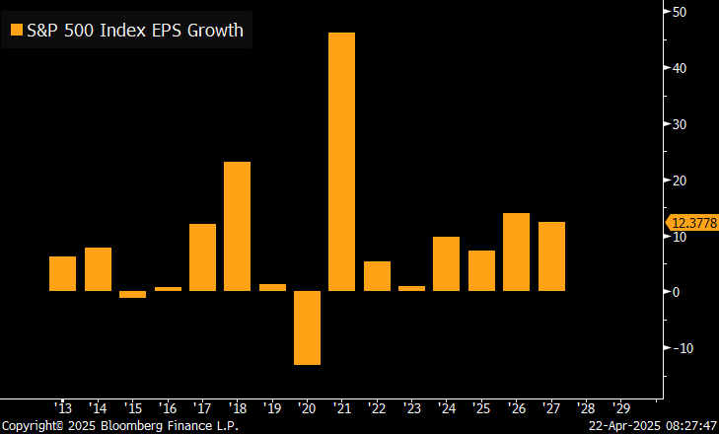
Earnings Cycle Offers Guide for US Stocks
* Source: Bloomberg Intelligence
Notes:
{NSN SQ4O37DWLU68 <GO>}

Slide 12
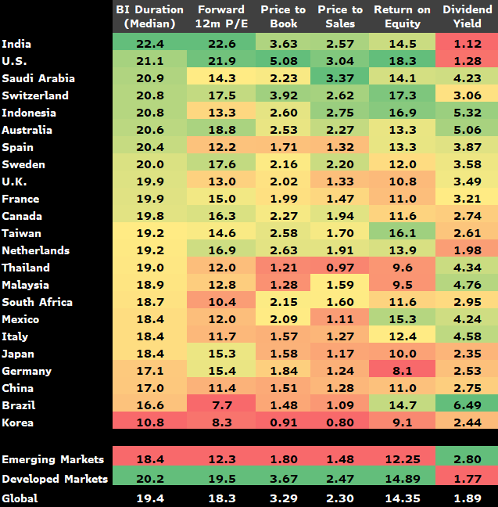
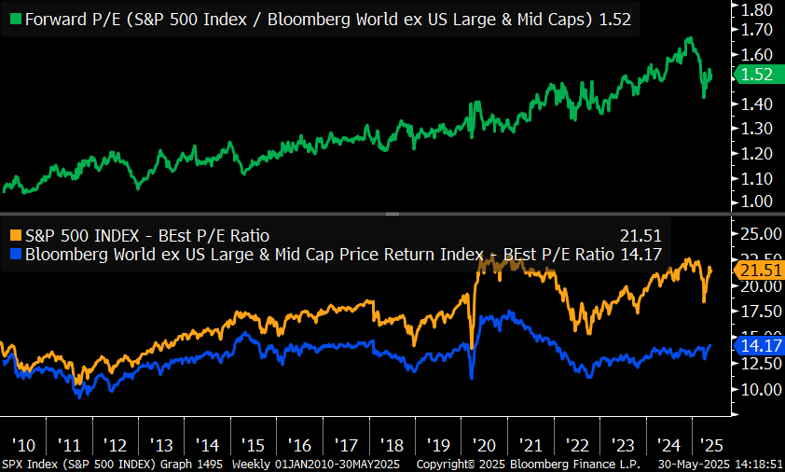
#3: Implied Expectations: High in US, Low Elsewhere
Global Valuations Reveal Some Discounts
Notes:
{NSN SU9QA9T1UM0W <GO>} {BPRV ID:465901 BITID:2511412 <GO>}

Slide 13
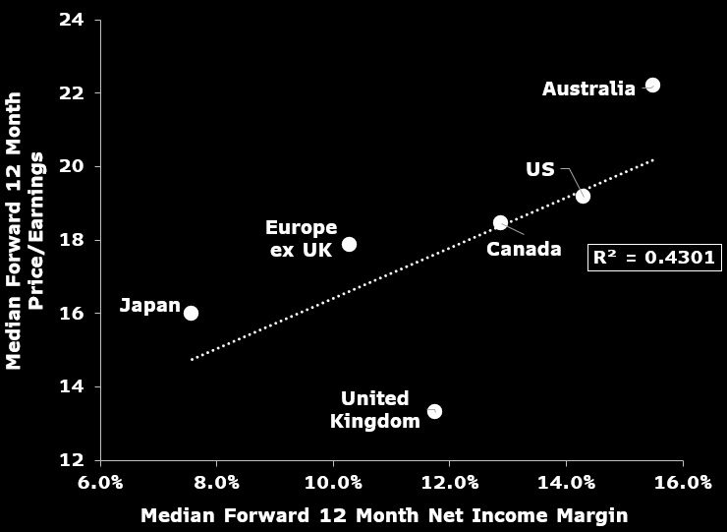
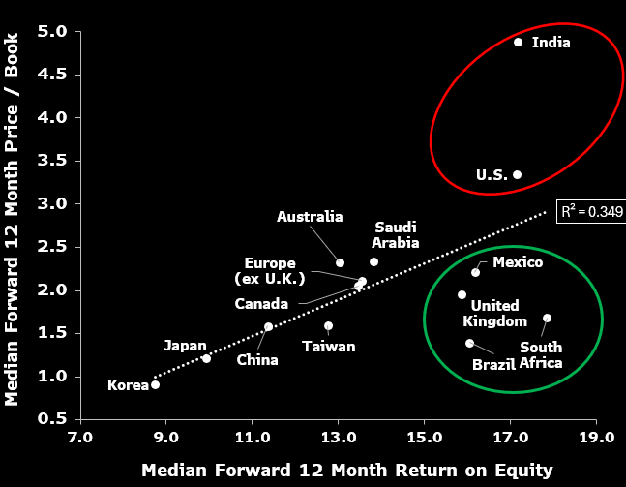
High Valuations Plaguing U.S. / India, Less So for the Rest
Source: Bloomberg Intelligence
Notes:
Both here: NSN SM9A66DWLU68

Slide 14
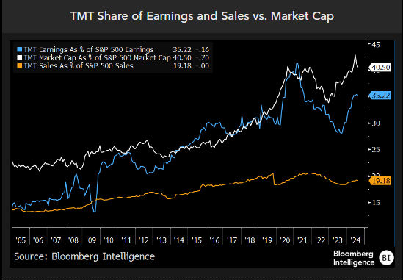
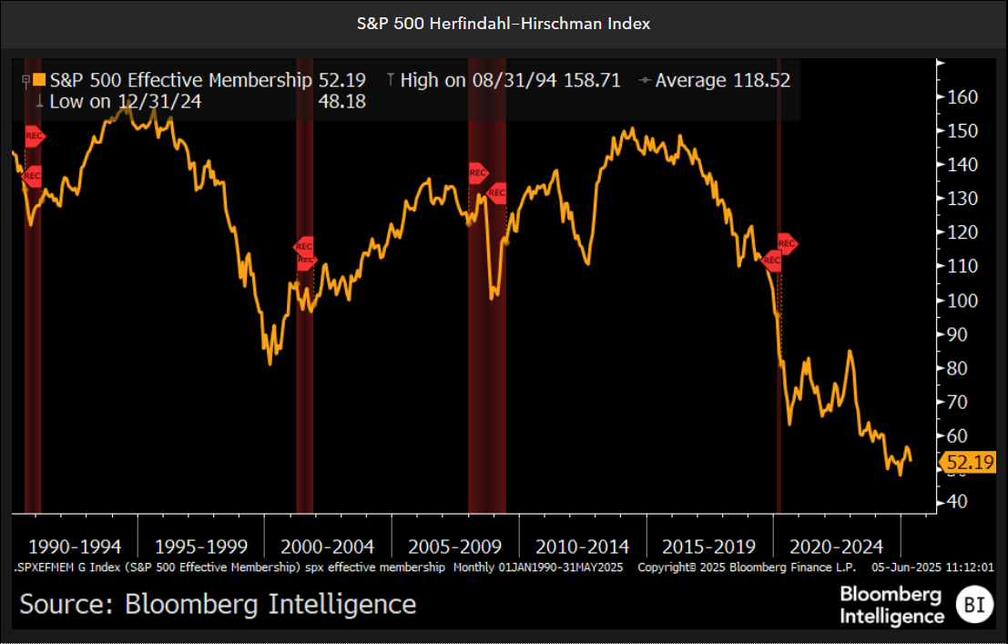
#4: Concentration Risk: U.S. Market Dependent on Tech
* Source: Bloomberg Intelligence
Notes:
Left: {NSN SHWBM8DWX2PS <GO>}
Right: NSN SFKYN7DWX2PS

Slide 15
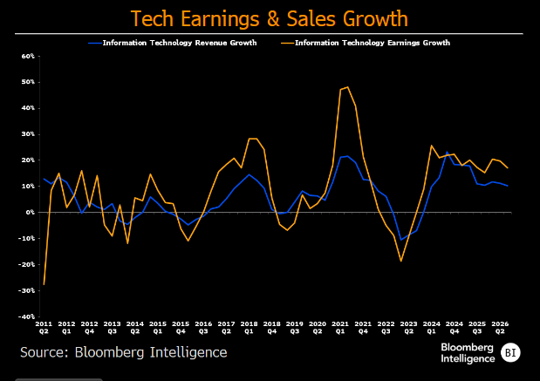
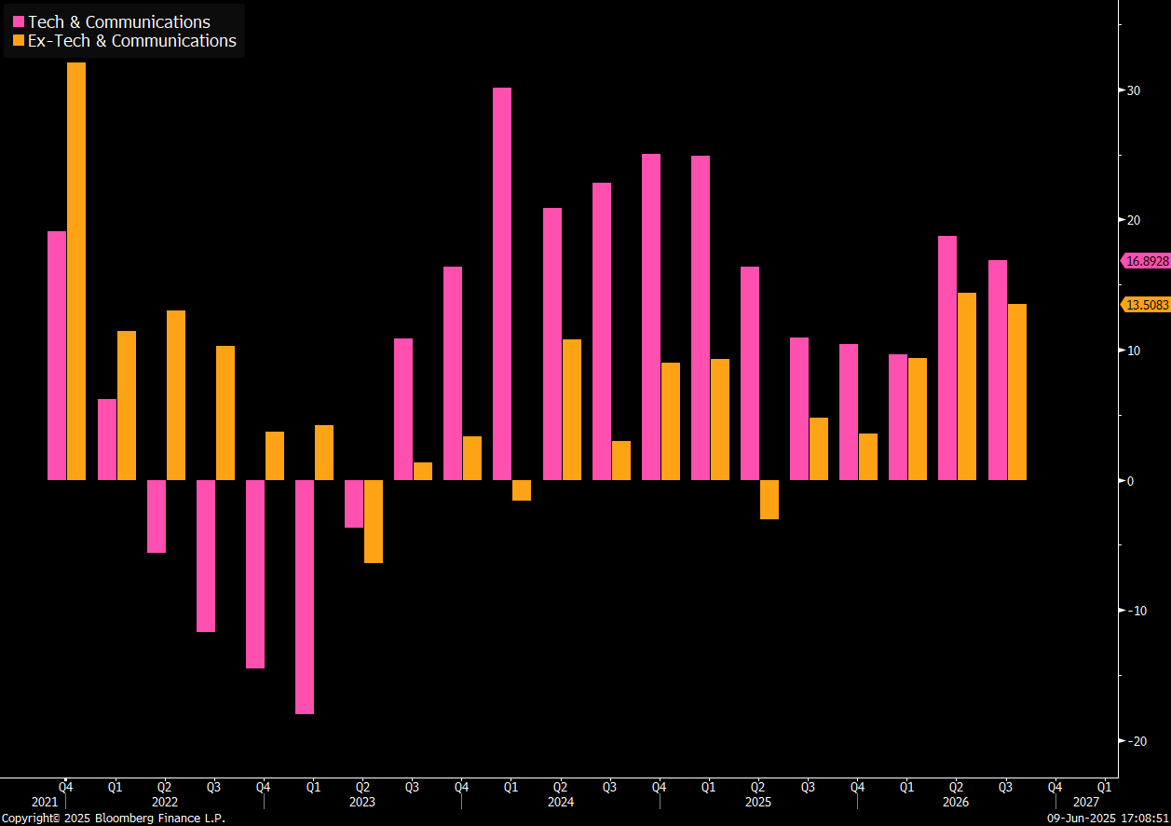
Tech Earnings Decelerating in 2025
Source: Bloomberg Intelligence
Notes:
from the STOXN dashboard. Links below:
TMT & ex-TMT {BI STOXN SPXERNR |2628-2-Q-Data|IL12||USD|X1768,1769<GO>}
{NSN SMPOQQT0AFB5 <GO>}

Slide 16
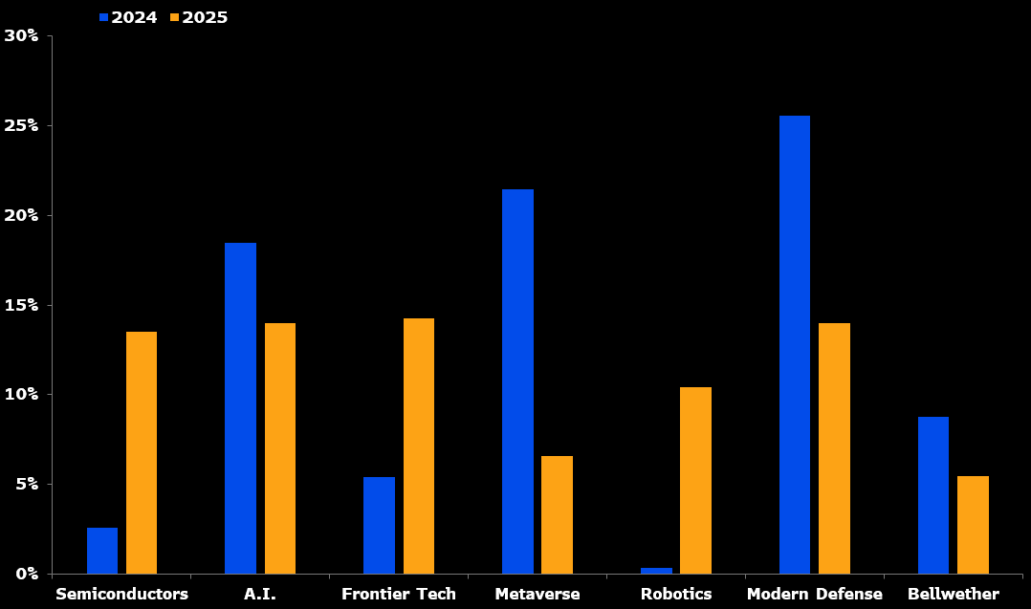
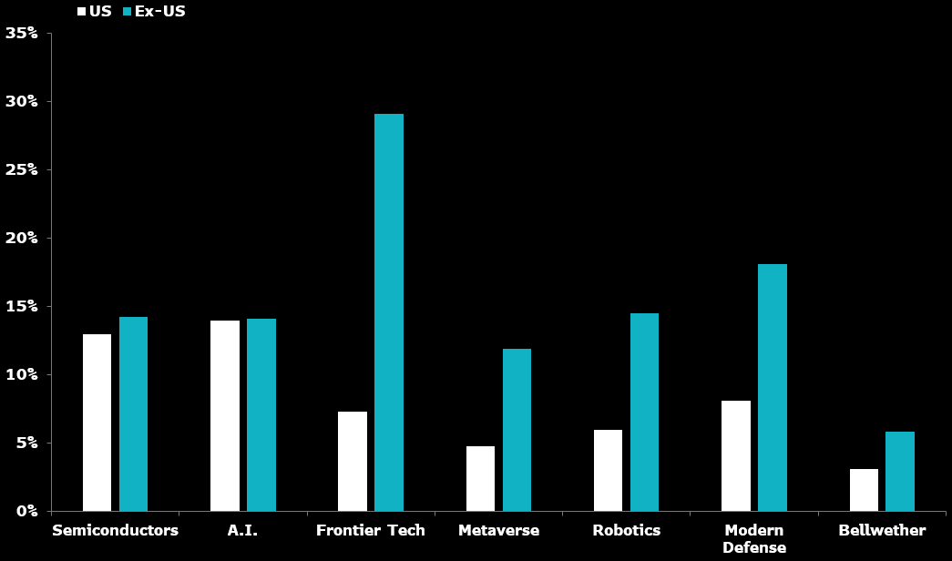
Median Net Income Growth for Tech Themes Better ROW
2025 Growth Slower than 2024
Growth Still Very Strong Outside of U.S.
Source: Bloomberg Intelligence
Notes:
All here: {NSN ST6T8BDWLU68 <Go>}

Slide 17
#5: Portfolio Strategies
-ERC Models
-Thematic Universes
-Sector Rotation Model
-Factor Strategy
-MVP Portfolios

Slide 18
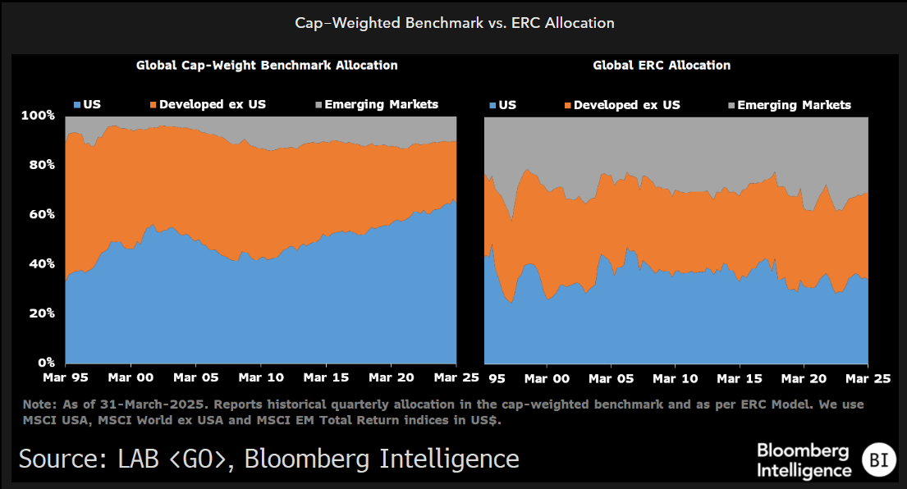
Equal Risk Contribution Portfolio Says 34% U.S. Allocation
Notes:
{BPRV ID:465901 BITID:2510298 <GO>}

Slide 19
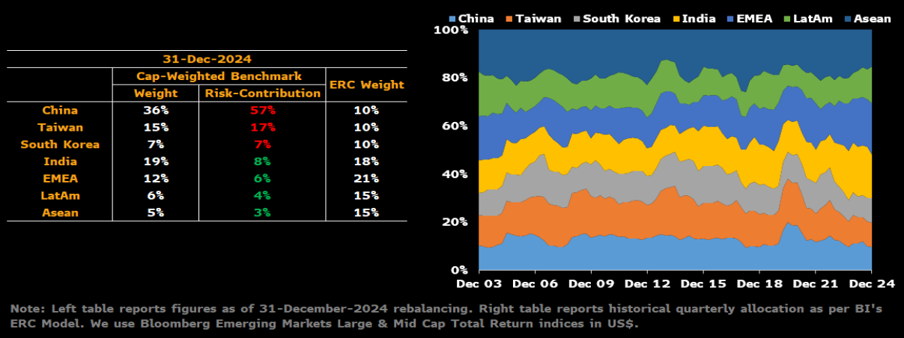
ERC Still Underweight China Due to Higher Volatility
* Source: Bloomberg Intelligence
Notes:
{NSN SGFIIIDWLU68 <GO>}

Slide 20
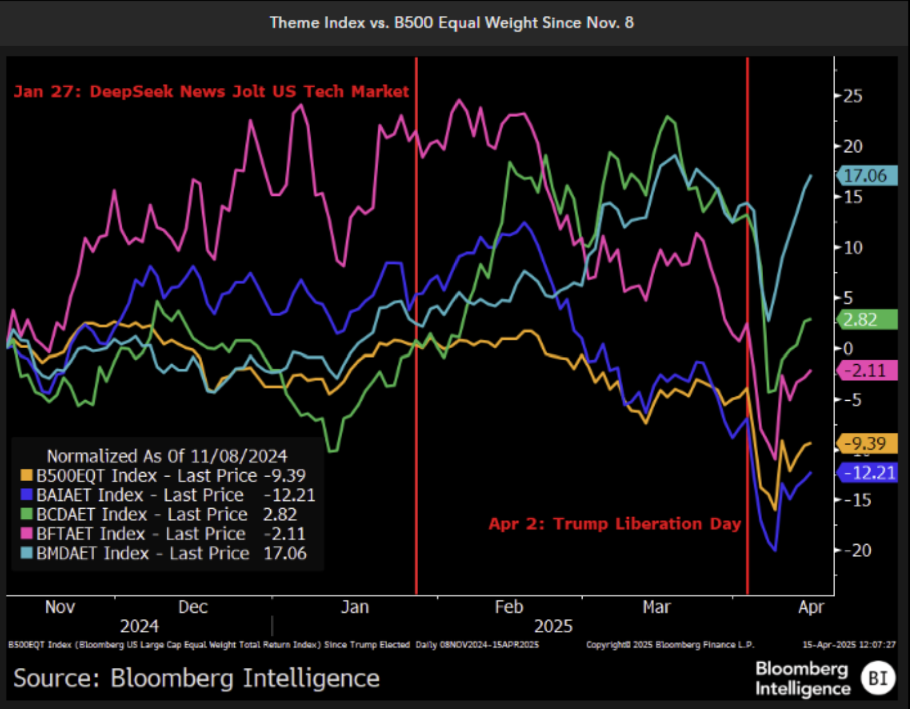
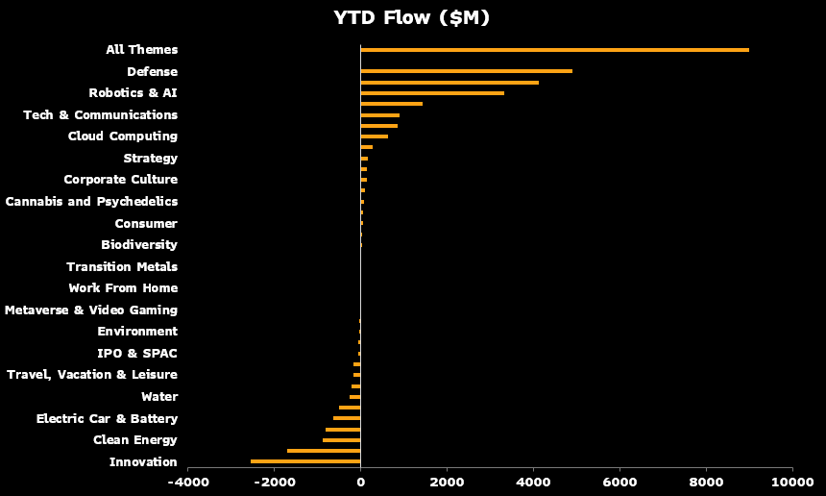
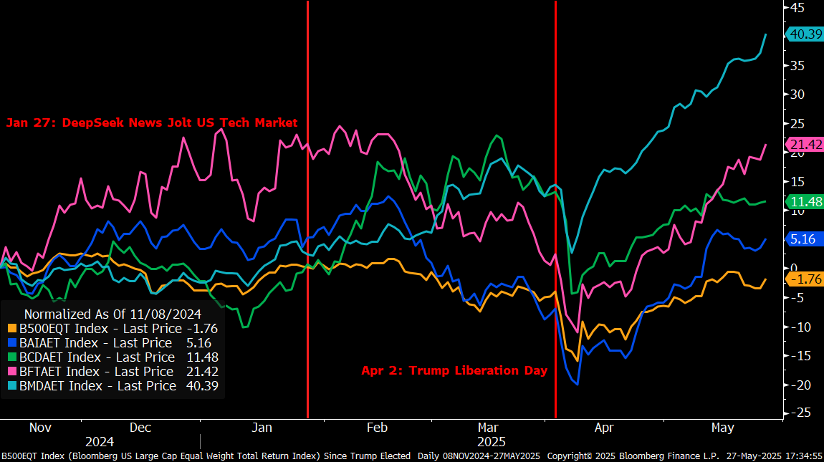
Themes Offer View of This Year’s Trends
Notes:
Here {NSN SUUZMADWLU68 <GO>} and in BI THEME library here: {BI BSKTG THEMETF |3044-2-W-Units|M12||USD<GO>}

Slide 21
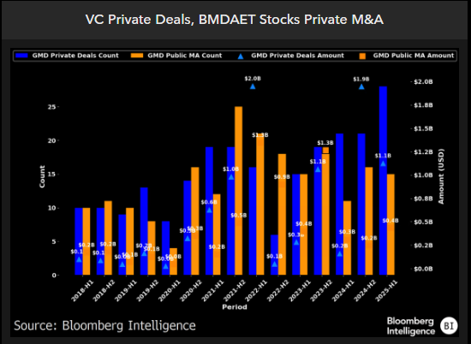
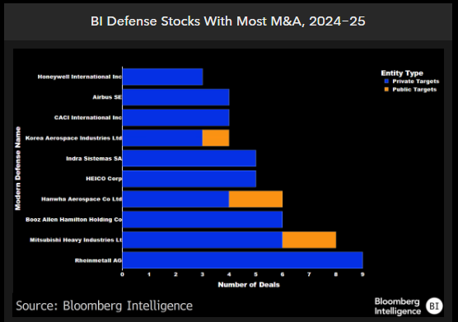
Investment in Modern Defense Surging Across Markets
Notes:
Both here: {NSN SVMS6IDWX2PS <GO>}

Slide 22
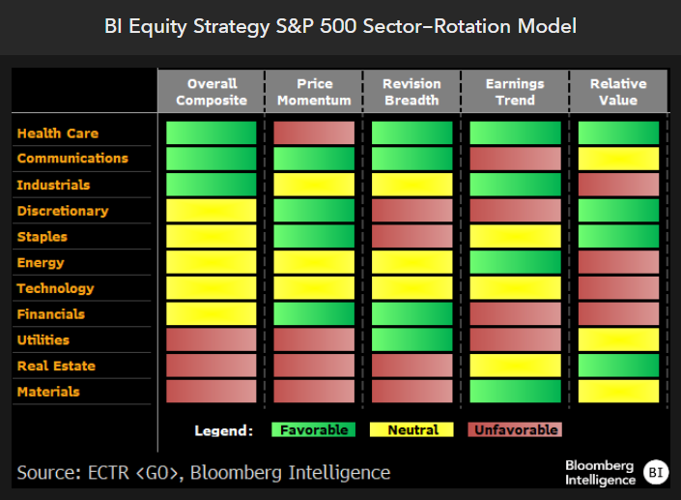
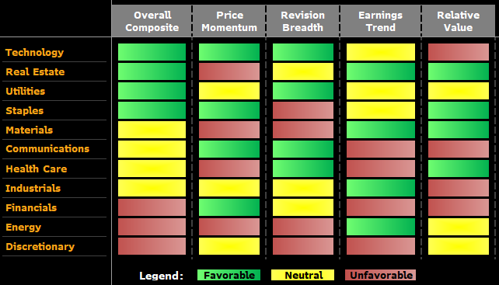
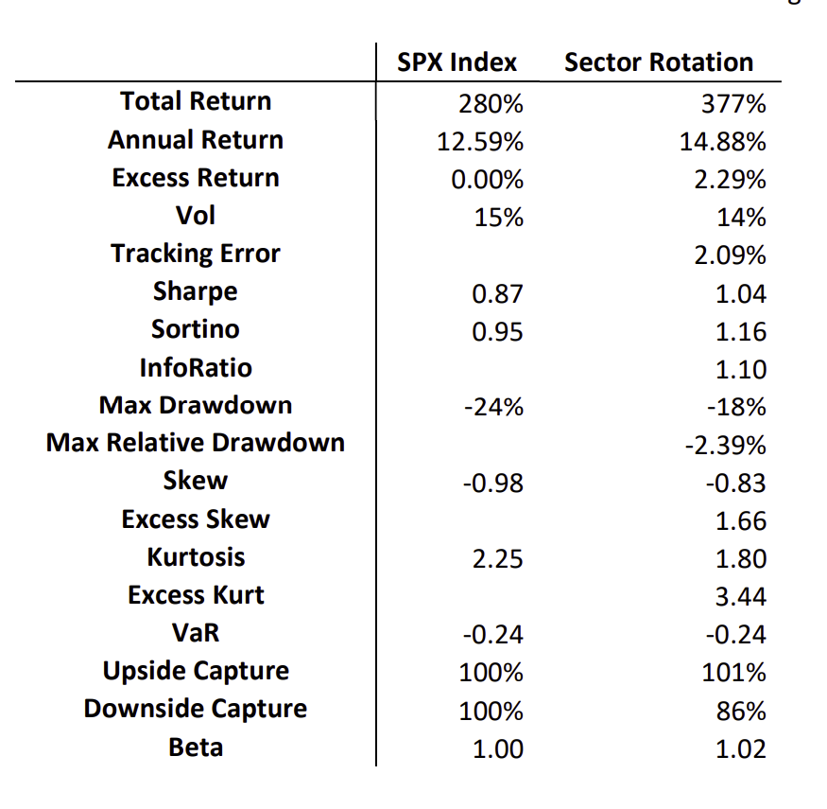
BI Large Cap Sector Rotation Model
Long Only Backtest, 2012-2023
Notes:
Put in new from BPAC, a/o last week
{NSN STZIU9T1UM0W <Go>}
At each quarter end rebalance, sectors are ranked by the metric scores, and an overweight position is taken on the indices corresponding to the top 3 sectors and an underweight position on the indices corresponding to the bottom 3 sectors. The top 3 sector indices are overweight by 7.5, 5, and 2.5 percentage points, and the bottom 3 sector indices are underweight by 7.5, 5, and 2.5 percentage points2 . However, not all sector index weights are high enough to take this large of an underweight position. In this case, we have a sector weight of 0, and underweight the 4th lowest sector to make up the difference up to 2.5 percentage points. Weights are then rescaled to 100% to ensure overweights and underweights are balanced.

Slide 23
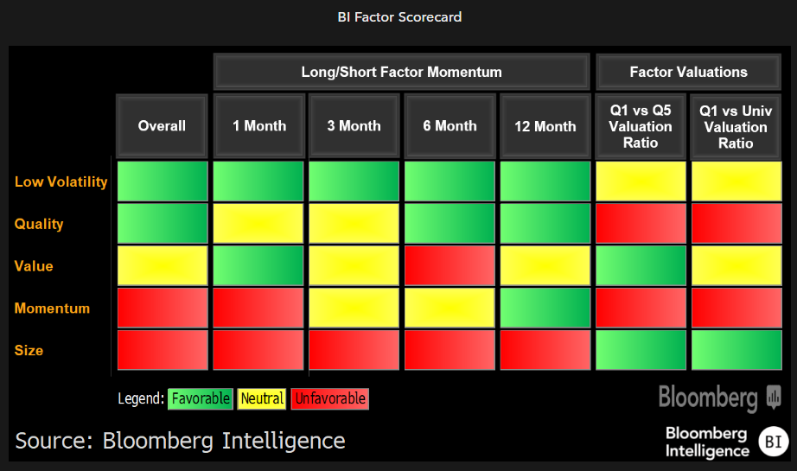
Factor Strategy Tilting to Low Volatility
Notes:
{NSN SU1ORHDWX2PS <GO>}

Slide 24
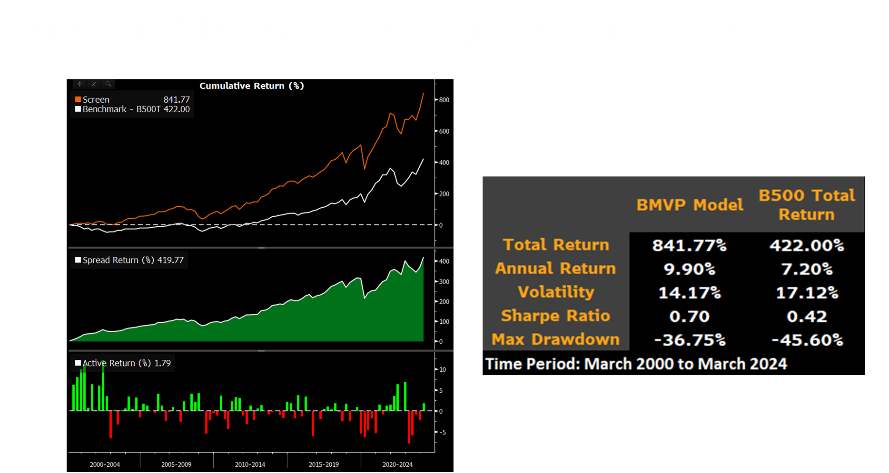
* Source: Bloomberg Intelligence
Notes:
{BPRV ID:391097 BITID:2110917 <GO>}

Slide 25
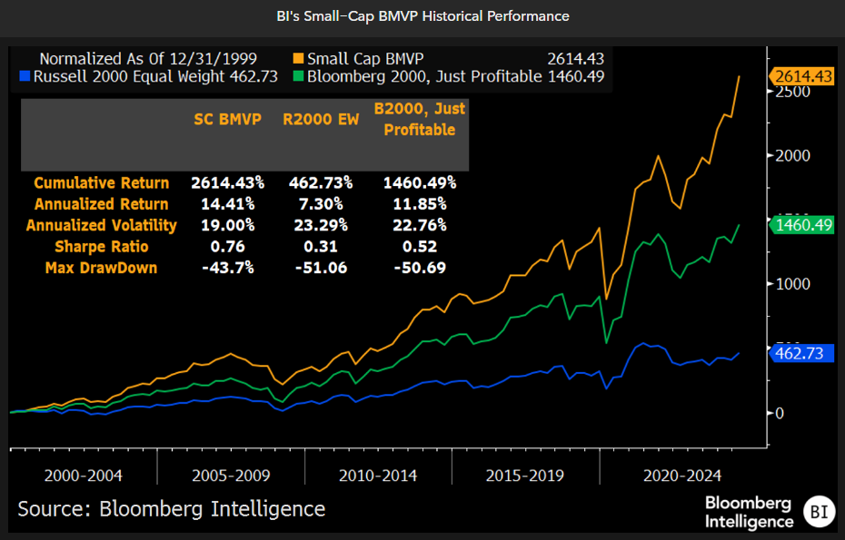
MVP on Profitable Small Caps Performs Well Too
Notes:
{NSN SLJSE9DWLU68 <GO>}

Slide 26
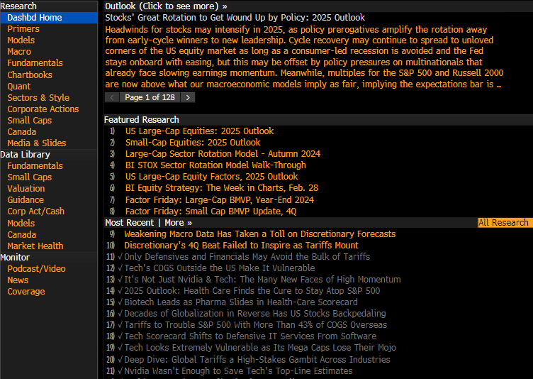

Visit us at BI STOX <Go>
BI/BE Macro Call
Mondays at 8.30AM EST
Zoom meeting ID: 992 5883 2350
Passcode: 798741
Zoom Breakfasts with BI STOX
Quarterly Webinar Content
Equity Market Minute Videos
Distribution List:
email gmartinadam1@bloomberg.net
@ginamartinadams
@pythontrader
@mikeacasper
@gillianwolff

Slide 27
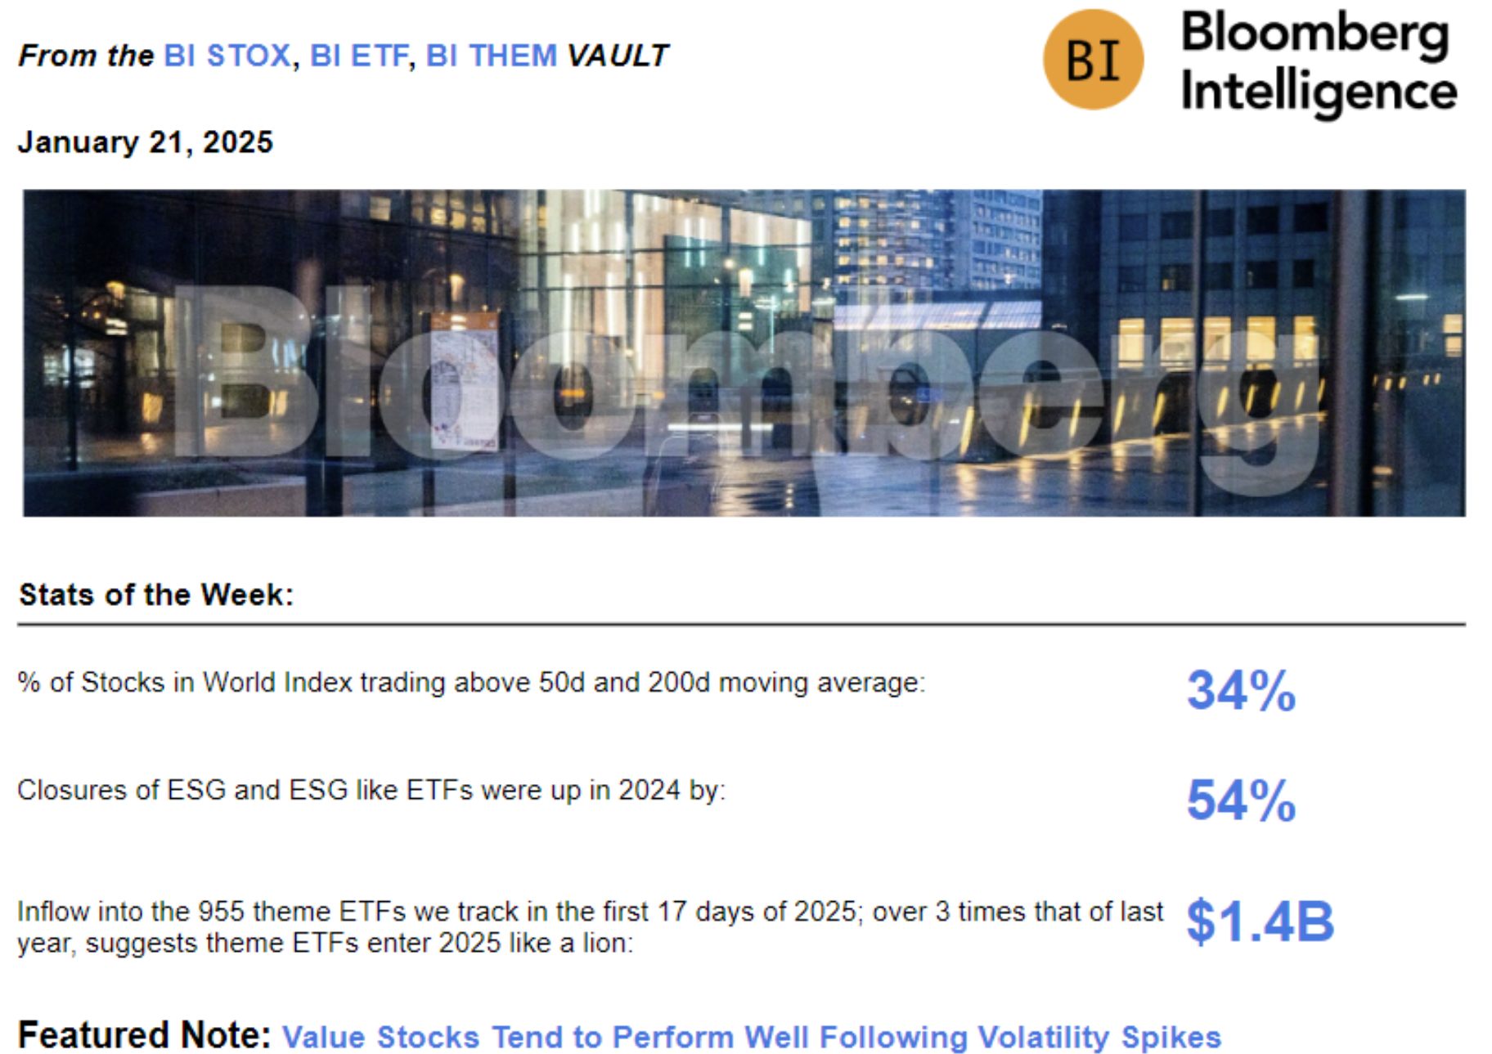
Visit Our Dashboards and Join our Distribution List
BI/BE Macro Call
Mondays at 8.30AM EST
Zoom meeting ID: 992 5883 2350
Passcode: 798741
Distribution List:
email gmartinadam1@bloomberg.net
@ginamartinadams

Slide 28
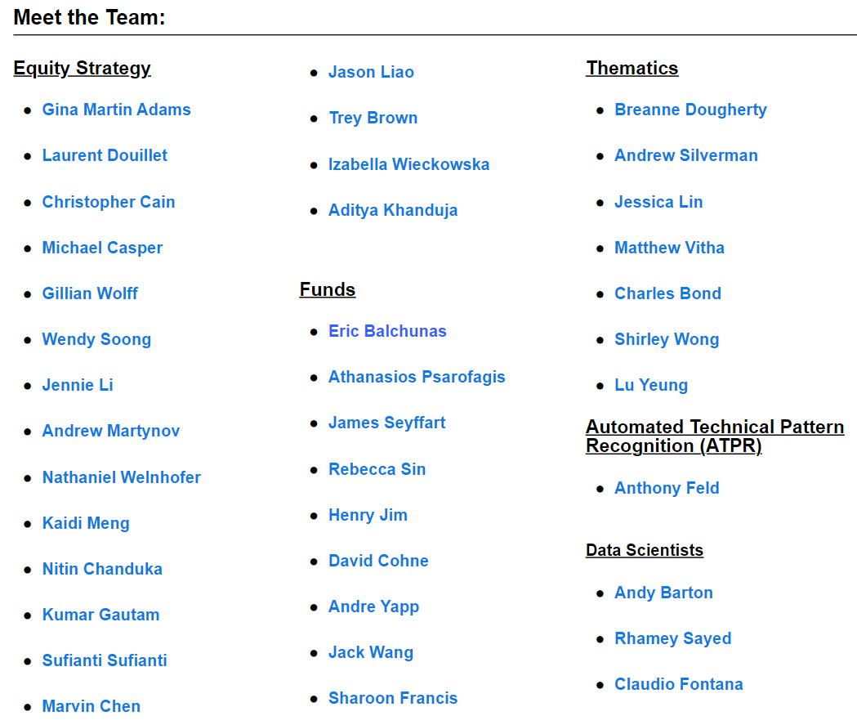
Notes:
New pic?

Slide 29
Thank you
For additional information, please contact your Bloomberg representative.
Beijing
+86 10 6649 7500
Dubai
+971 4 364 1000
Frankfurt
+49 69 9204 1210
Hong Kong
+852 2977 6000
London
+44 20 7330 7500
Mumbai
+91 22 6120 3600
New York
+1 212 318 2000
San Francisco
+1 415 912 2960
São Paulo
+55 11 2395 9000
Singapore
+65 6212 1000
Sydney
+61 2 9777 8600
Tokyo
+81 3 4565 8900

Slide 30
Disclaimer
The data included in these materials are for illustrative purposes only. The BLOOMBERG TERMINAL service and
Bloomberg data products (the “Services”) are owned and distributed by Bloomberg Finance L.P. (“BFLP”) except (i)
in Argentina, Australia and certain jurisdictions in the Pacific islands, Bermuda, China, India, Japan, Korea and New
Zealand, where Bloomberg L.P. and its subsidiaries (“BLP”) distribute these products, and (ii) in Singapore and the
jurisdictions serviced by Bloomberg’s Singapore office, where a subsidiary of BFLP distributes these products. BLP
provides BFLP and its subsidiaries with global marketing and operational support and service. Certain features,
functions, products and services are available only to sophisticated investors and only where permitted. BFLP, BLP
and their affiliates do not guarantee the accuracy of prices or other information in the Services. Nothing in the
Services shall constitute or be construed as an offering of financial instruments by BFLP, BLP or their affiliates, or as
investment advice or recommendations by BFLP, BLP or their affiliates of an investment strategy or whether or not
to “buy,” “sell,” or “hold” an investment. Information available via the Services should not be considered as
information sufficient upon which to base an investment decision. The following are trademarks and service marks
of BFLP, a Delaware limited partnership, or its subsidiaries: BLOOMBERG, BLOOMBERG ANYWHERE, BLOOMBERG
MARKETS, BLOOMBERG NEWS, BLOOMBERG PROFESSIONAL, BLOOMBERG TERMINAL and BLOOMBERG.COM.
Absence of any trademark or service mark from this list does not waive Bloomberg’s intellectual property rights in
that name, mark or logo. All rights reserved. © 2024 Bloomberg.
Bloomberg Intelligence is a service provided by Bloomberg Finance L.P. and its affiliates. ("Bloomberg"). Bloomberg
is not an officially recognized credit rating agency in any jurisdiction, and customers should not use or rely on
Bloomberg Intelligence to comply with applicable laws or regulations that prescribe the use of ratings issued by
accredited or otherwise recognized credit rating agencies. Bloomberg Intelligence Credit and Company research
may not be available in certain jurisdictions.
Bloomberg Intelligence shall not constitute, nor be construed as, investment advice or investment
recommendations (i.e., recommendations as to whether or not to “buy,” “sell,” “hold,” or to enter or not to enter
into any other transaction involving any specific interest) or a recommendation as to an investment or other
strategy. No aspect of the Bloomberg Intelligence function is based on the consideration of a customer's individual
circumstances. Bloomberg Intelligence should not be considered as information sufficient upon which to base an
investment decision. Customers should determine on their own whether they agree with Bloomberg Intelligence.
Bloomberg Intelligence should not be construed as tax or accounting advice or as a service designed to facilitate
any Bloomberg Intelligence customer’s compliance with its tax, accounting, or other legal obligations. Bloomberg
believes that the information it uses in Bloomberg Intelligence comes from reliable sources, but does not guarantee
the accuracy of information contained in Bloomberg Intelligence. Employees involved in Bloomberg Intelligence
may hold positions in the securities analyzed or discussed on Bloomberg Intelligence

