Slide 1
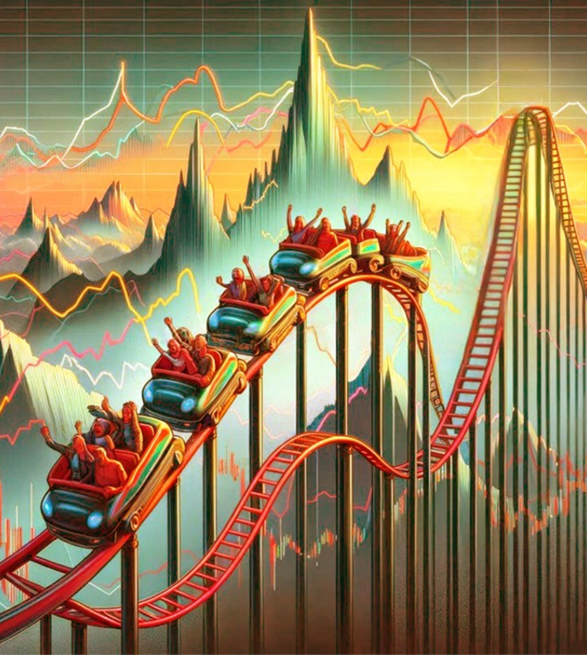
Navigating Q4 2025 and beyond:
Aiming to answer 5 FAQs
September 2025
Notes:
“

Slide 2

FAQ #1
What are the key takeaways from this year?
Notes:
“

Slide 3
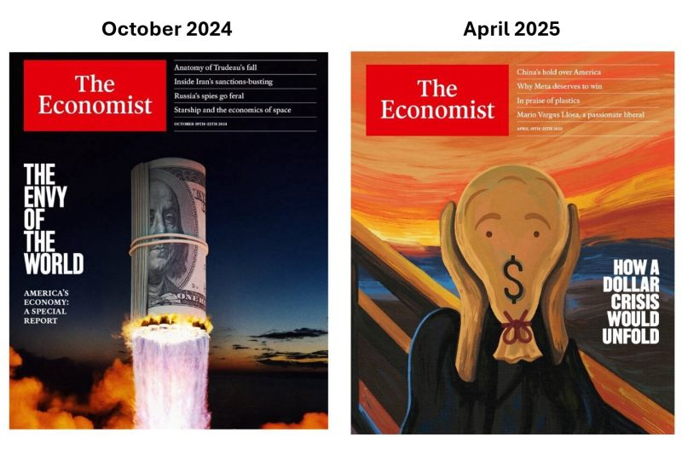
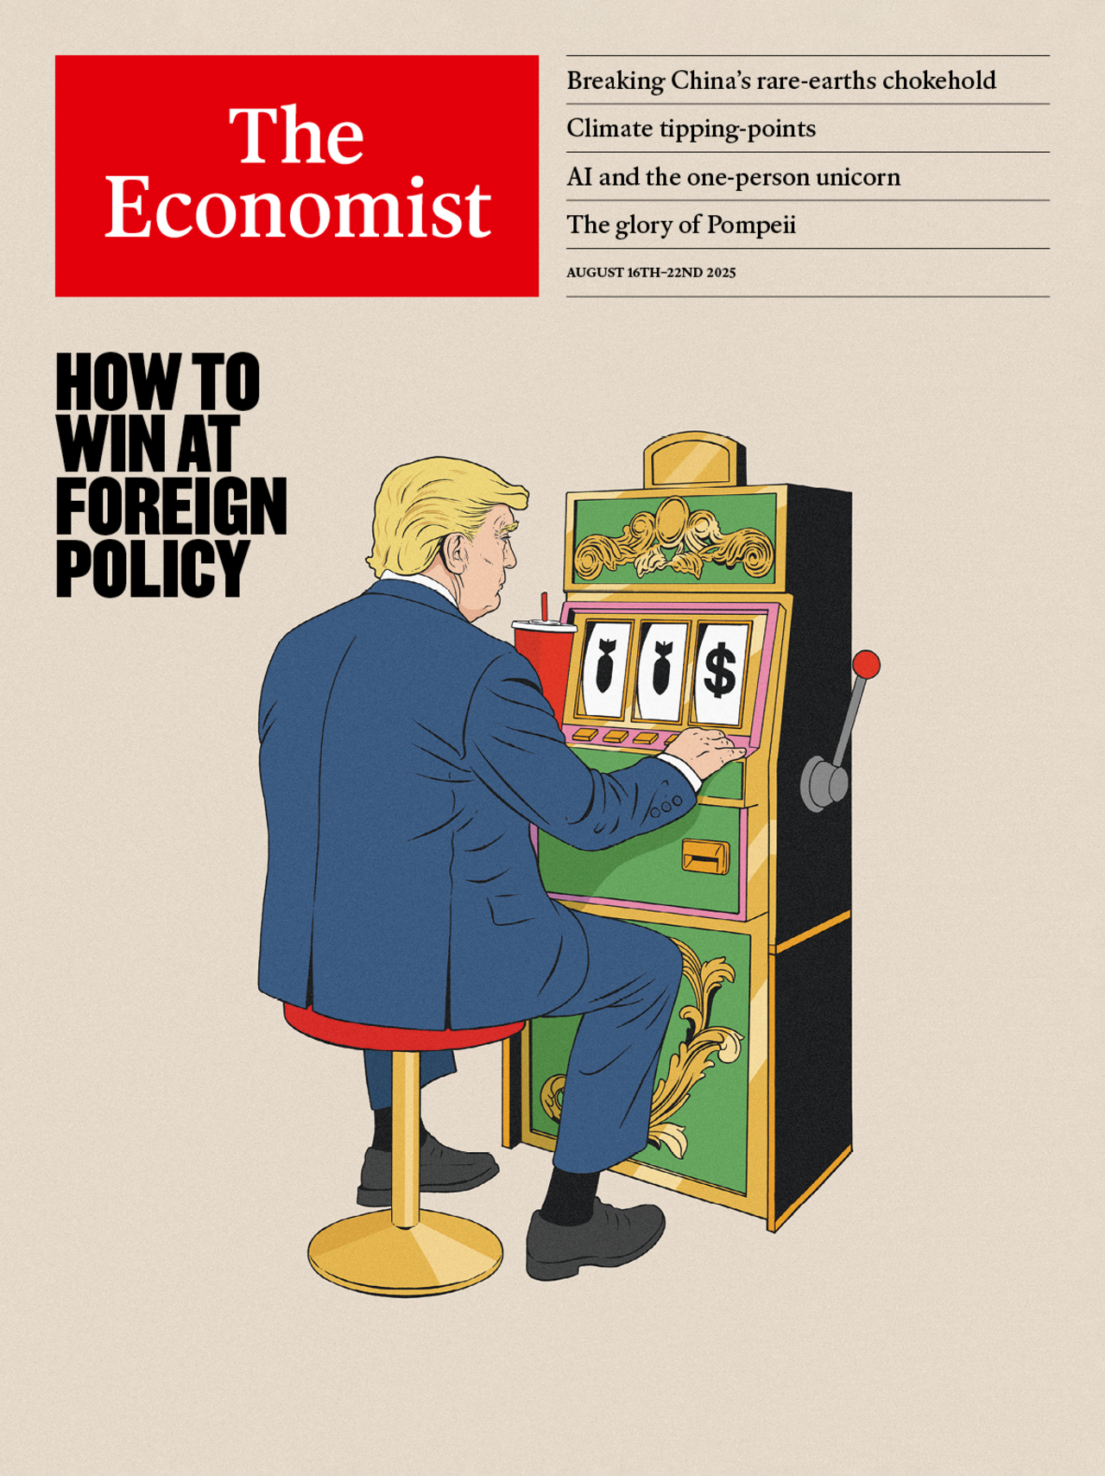
From US exceptionalism to US bashing...to US exceptionalism again
October 2024
April 2025
August 2025

Slide 4

2025 events have shaken faith in American exceptionalism

Slide 5
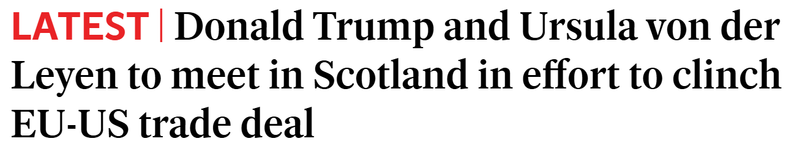

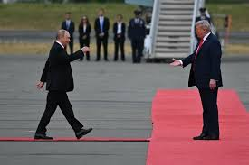


Geopolitical power dwarf economic power
Mario Draghi: “2025 events quashed any illusion that economic power alone would be able to guarantee any form of geopolitical power”
2024 GDP $19.4 trillion
2024 GDP $2.4 trillion

Slide 6
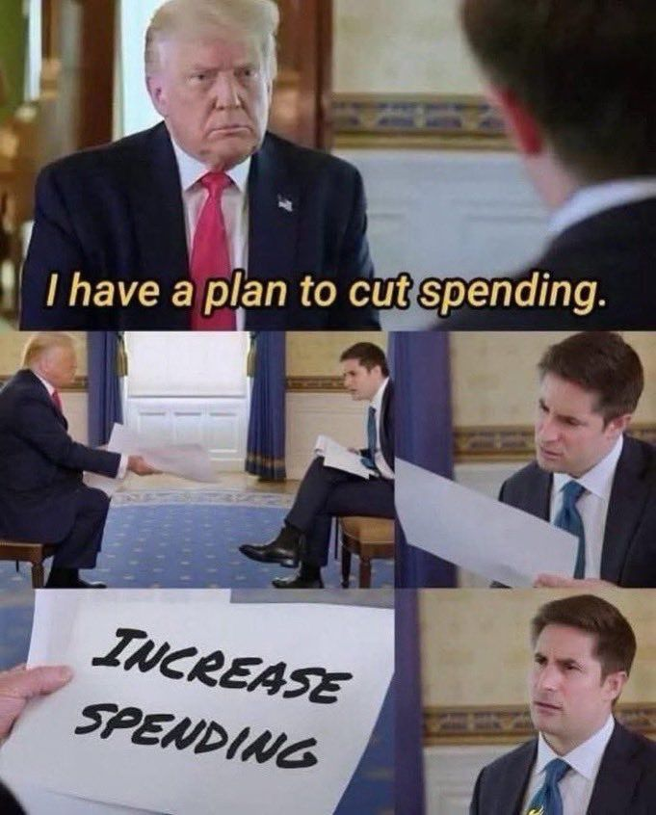
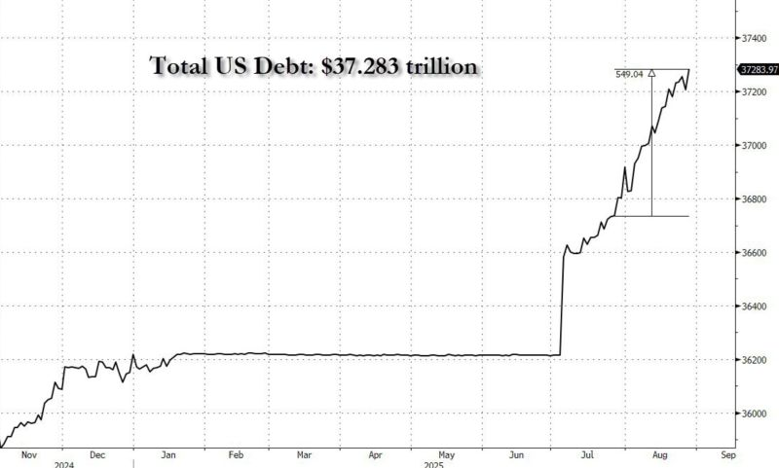
Forget about D.O.G.E, fiscal discipline, and debt reduction…

Slide 7
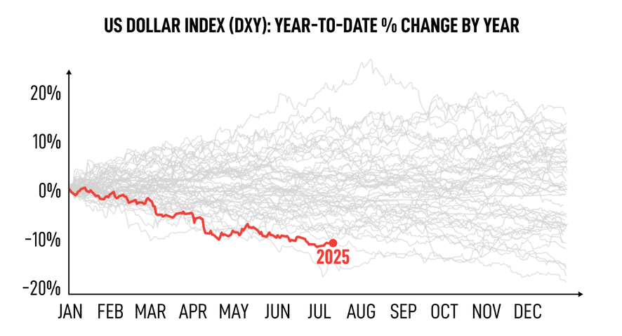

The dollar: “Our currency, your problem”

Slide 8
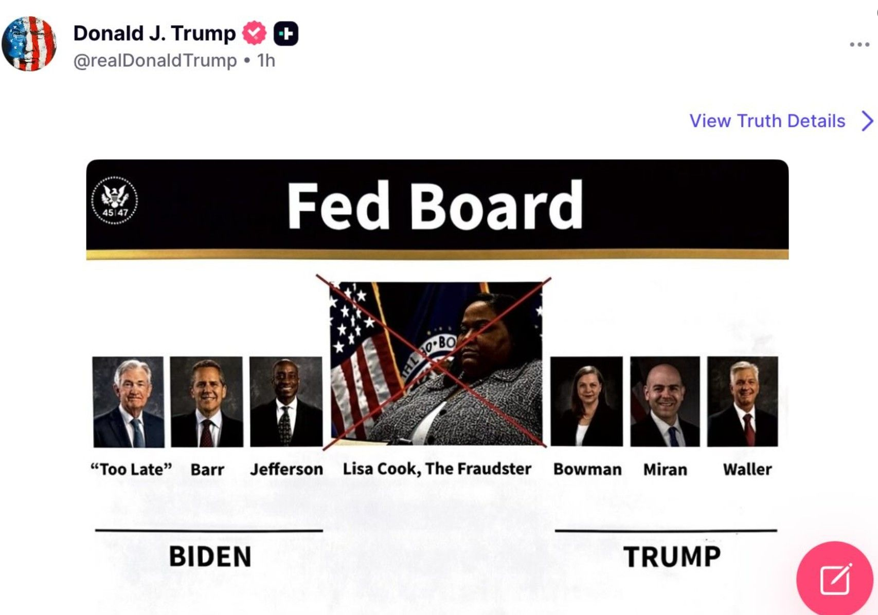
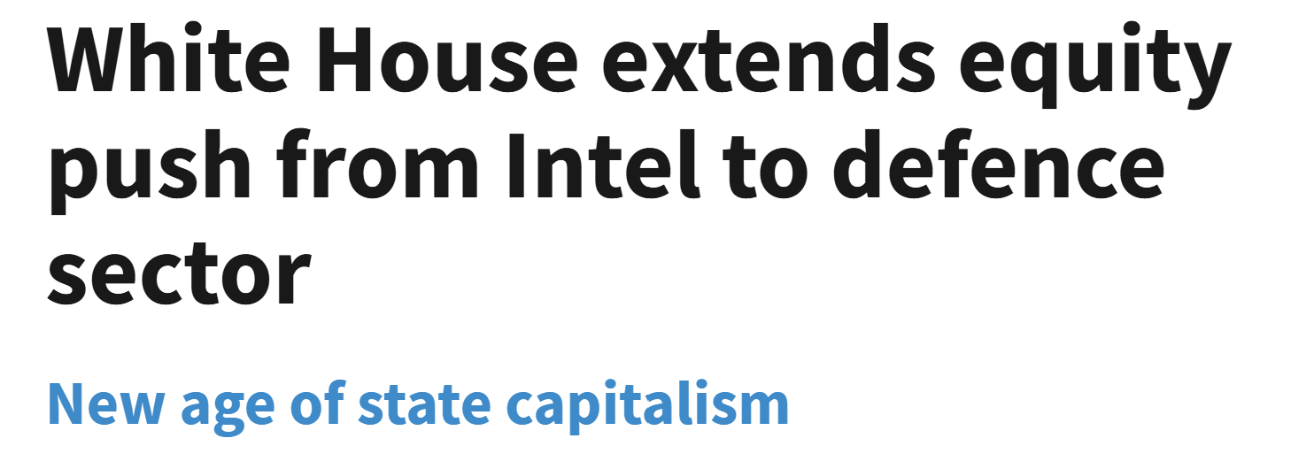
US “ultraliberalism”? Not the playbook we were expecting…

Slide 9
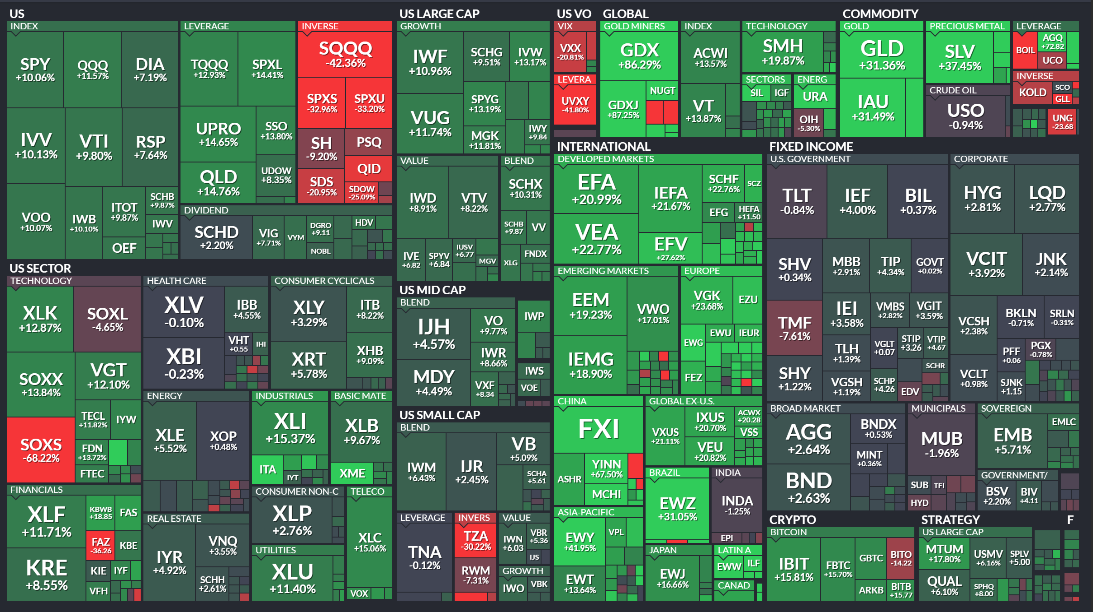
Despite all these scary headlines, a sea of green
YTD Performance as of 30.8.2025 (in $):
📈 Developed: +22.77%
📈 EAFE: +20.99%
📈 Emerging: +19.23%
📈S&P: +10.06%
📈QQQ: +11.57%
📈Dow: +7.19%
📈Russell: +7.64%
🛢️Oil: -10.75%
💵US Dollar: -9.80%
🥇Gold: +31.40%
₿ Bitcoin: +16.06%
In red: mainly short / inverse ETFs

Slide 10

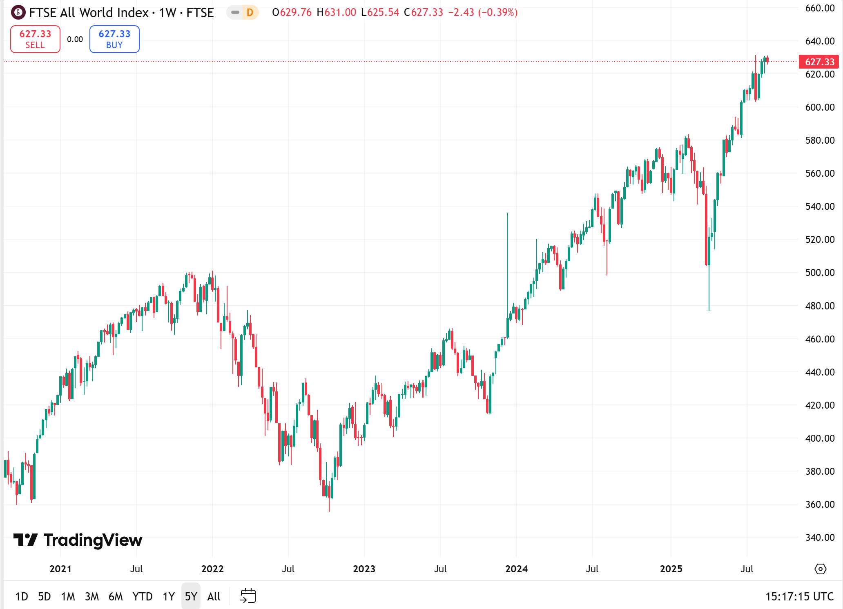
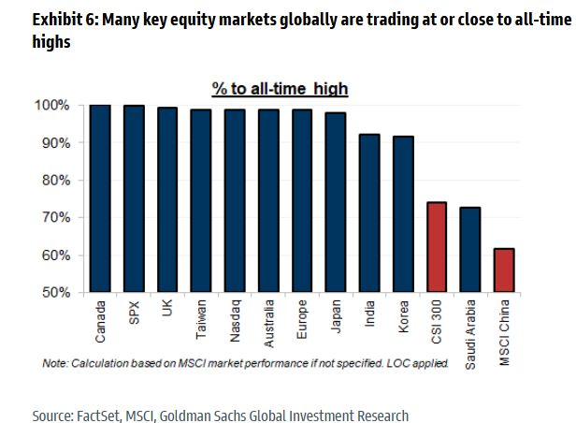
The FTSE All World index hit a new all-time-high

Slide 11

FAQ #2
How have markets been so resilient?
Notes:
“

Slide 12

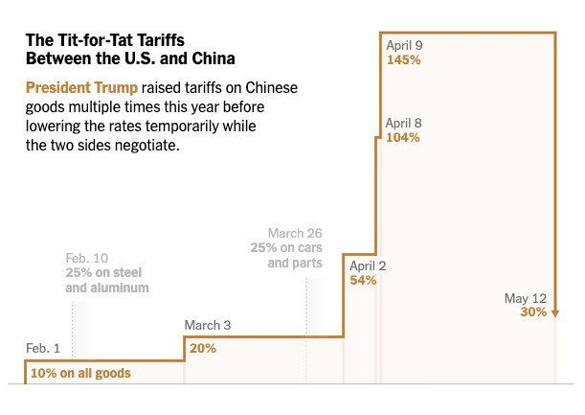
Welcome to the “T.A.C.O trade”

Slide 13
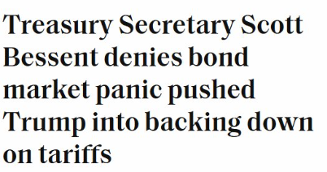
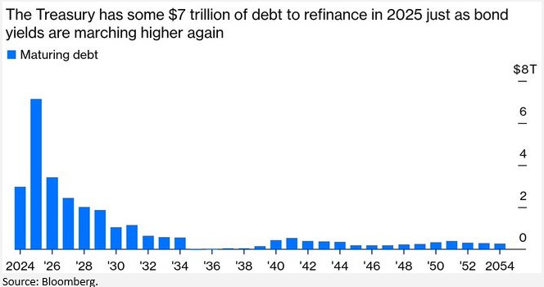

The bond market can intimidate anyone… even Donald Trump
Source: Global Markets Investor, FRED, Bloomberg

Slide 14
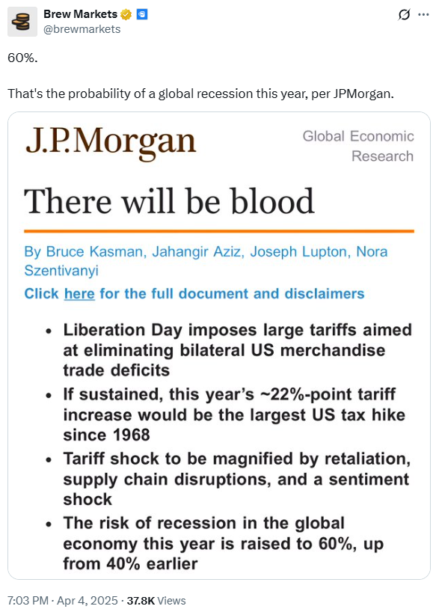
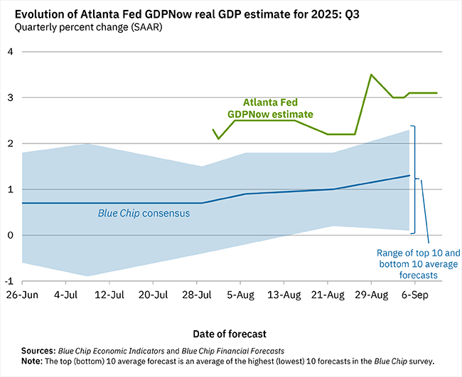
Recession? What recession?
CANCELED
Source: Atlanta Fed

Slide 15
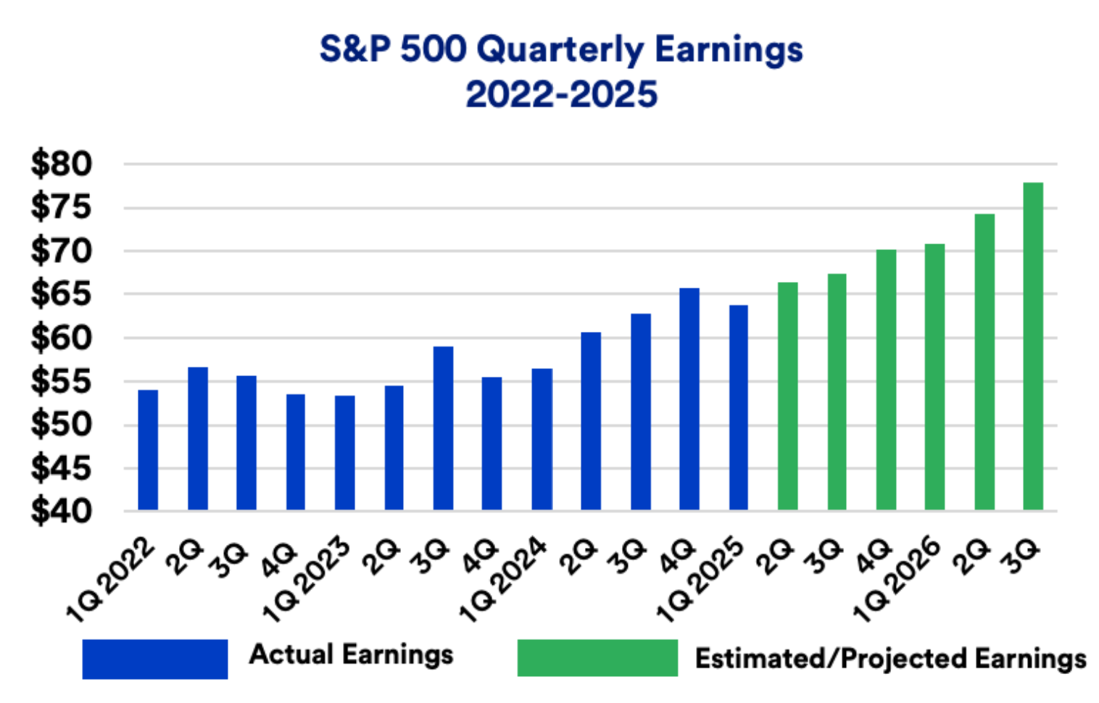
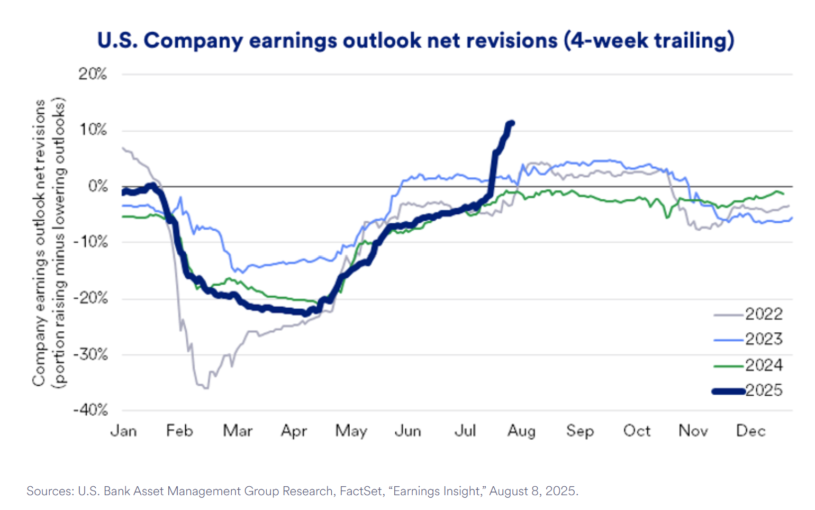
The resilience of US earnings

Slide 16
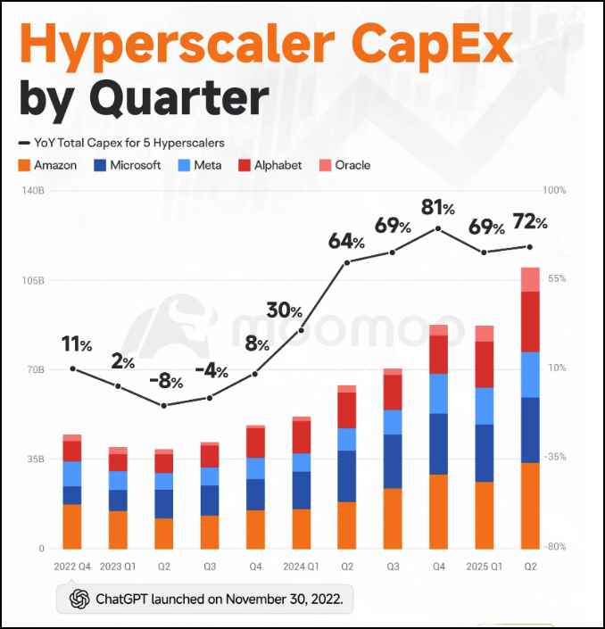
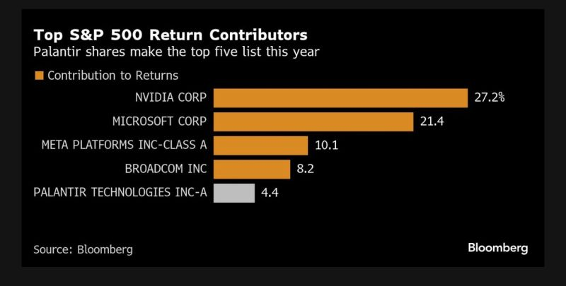
5 stocks account for nearly 70% of the S&P 500 YTD performance

Slide 17
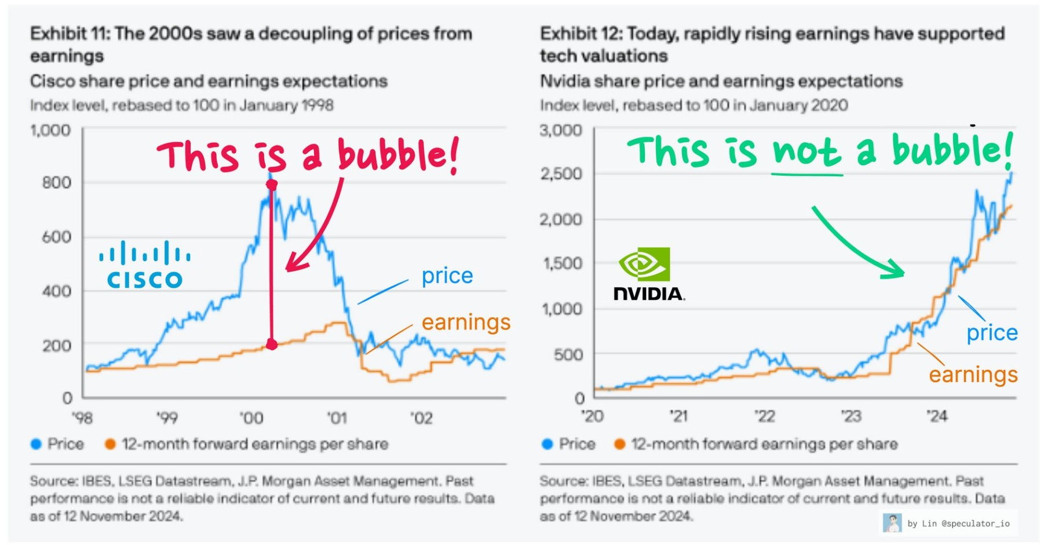
The “GenAI” bull market
  Debate this year has centered on sustainability: risks of overcapacity, uncertain monetization, and the drag of higher capex.
  But AI firms today are not selling promises, they are booking contracted revenue tied to real adoption. That distinction from dot-com history matters.

Slide 18
The GenAI is a multi-year, multi-sector growth engine
AI chip design: Nvidia remains the leader, and Oracle’s guidance validates Nvidia’s CEO Jensen Huang’s forecast of $3–4tn in global AI infrastructure spend by 2030. We also note Broadcom’s recent strong numbers and bullish comments on its custom AI chips business, while AMD and Arm remain credible challengers.
AI chip manufacturing: TSMC is the clear winner, with unmatched scale and technology.
Datacentre hardware: multiple companies are poised to benefit, including names such as Arista (high-speed interconnects), Vertiv (cooling), Amphenol (cabling), and server makers like Super Micro Computer and Dell
Large language models: privately owned start-ups dominate this space, but among listed stocks, we note that Alphabet is no longer viewed as a laggard in AI models / chatbots, thanks to the significant progress it has made with its Gemini product.
Cloud hyperscalers: Microsoft, and Alphabet have seen a reacceleration in their cloud business, Amazon trends were stable but near-term comments were bullish too. Chinese hyperscaler Alibaba has also printed strong surge cloud revenue. Moreover, there are new entrants in this space, from Oracle, to more recent ones such as Coreweave or Nebius.
AI software / Agentic AI: AI monetization will come in phases: Nvidia is benefitting from the datacenter buildout stage, Oracle, Google and Microsoft are benefitting from renting AI infrastructure. We believe software firms stand to benefit as AI adoption widens, and today Salesforce and ServiceNow appear to have the most advanced agentic AI products in this space

Slide 19
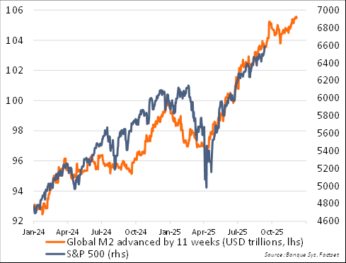
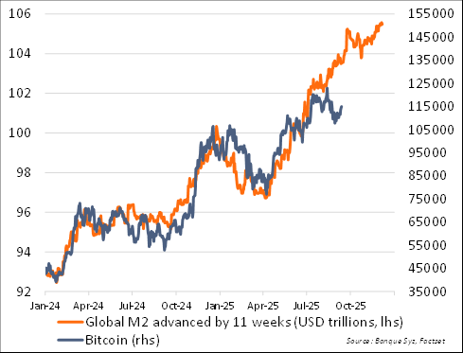
It’s liquidity, stupid!
Global M2
vs. S&P 500 lagged 11 weeks
Global M2
vs. bitcoin lagged 11 weeks

Slide 20

FAQ #3
Is it the end of US exceptionalism?
Notes:
“

Slide 21
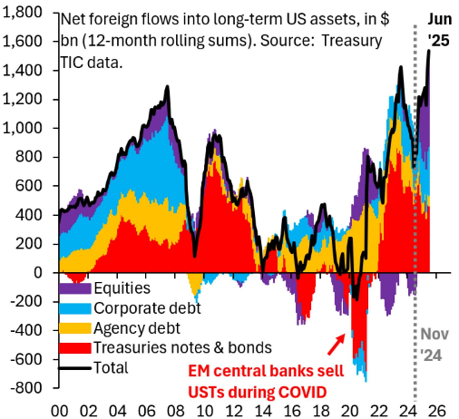
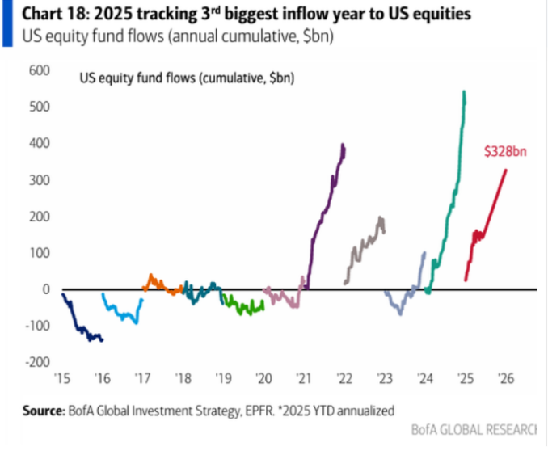
Foreign flows: no signs of US defiance at this stage
Source: Goldman Sachs, EPFR, BofA

Slide 22
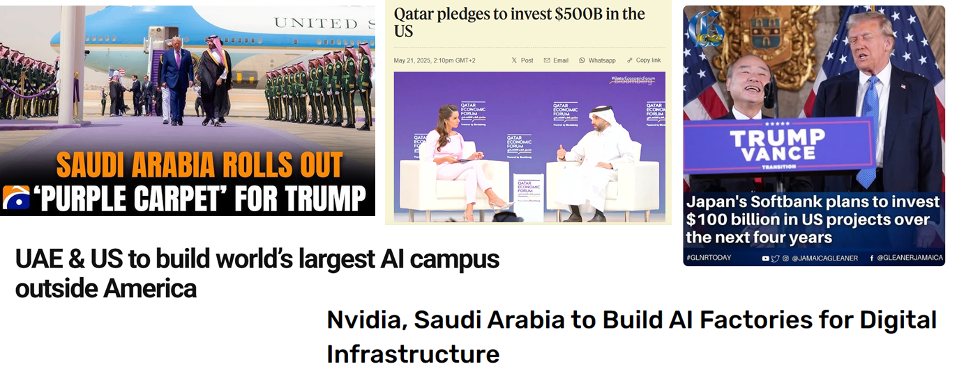
Some regions in the world have never been so pro-US…

Slide 23
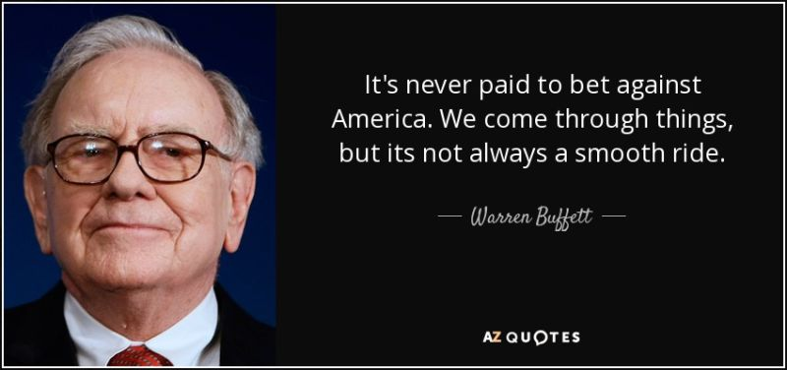
Warren Buffet: “Don’t bet against America”...
  ”With just 4% of the world’s population, we lead in INNOVATION, CAPITAL, TALENT & GLOBAL INFLUENCE” – Warren Buffet

Slide 24
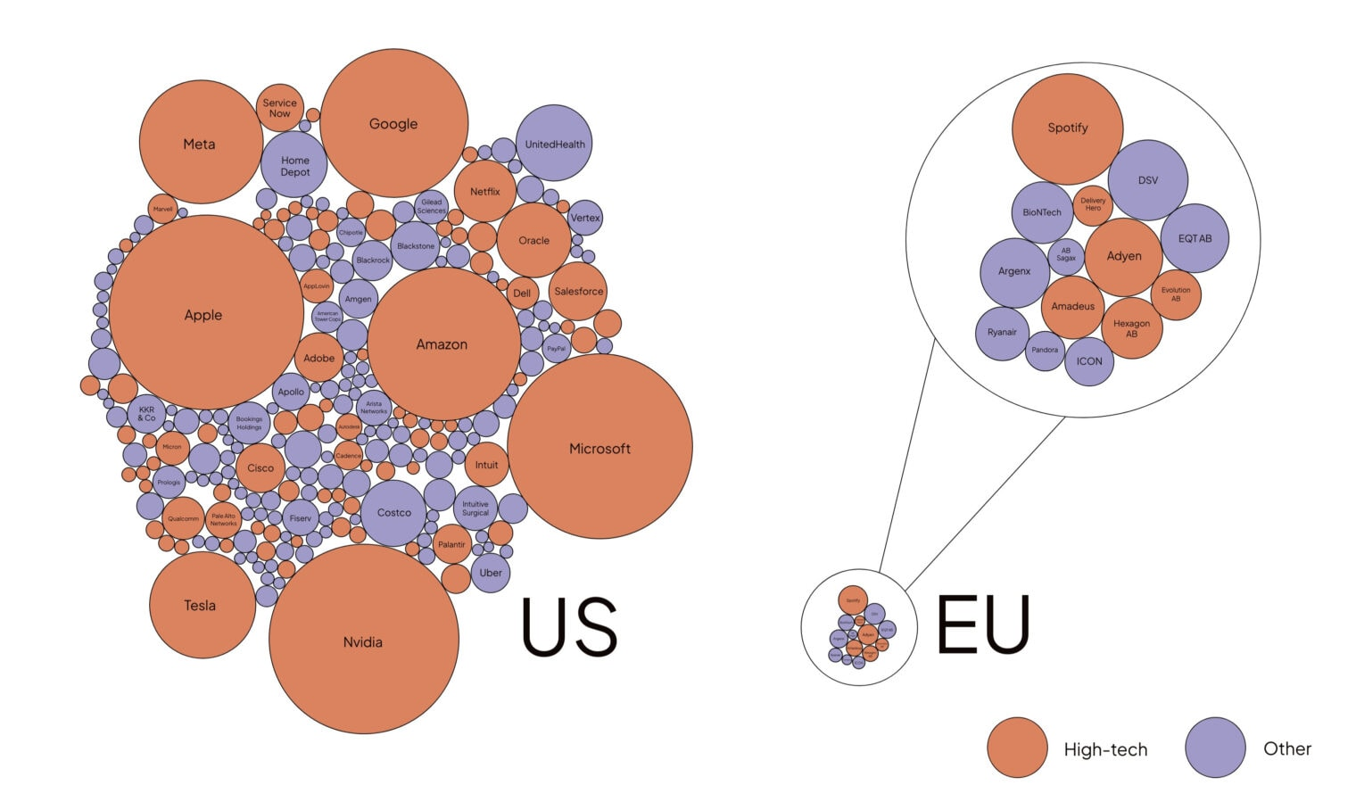
Do you think this is likely to change?
  Publicly traded companies founded less than 50 years ago with $10B+ Market Cap

Slide 25
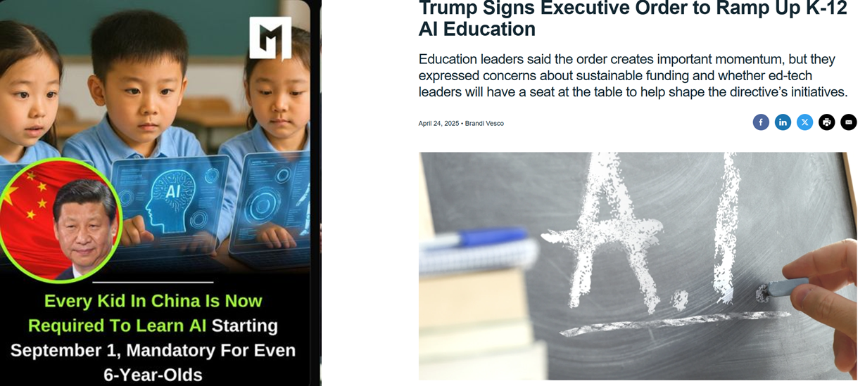
For the time being, generative AI remains a US-China race…

Slide 26
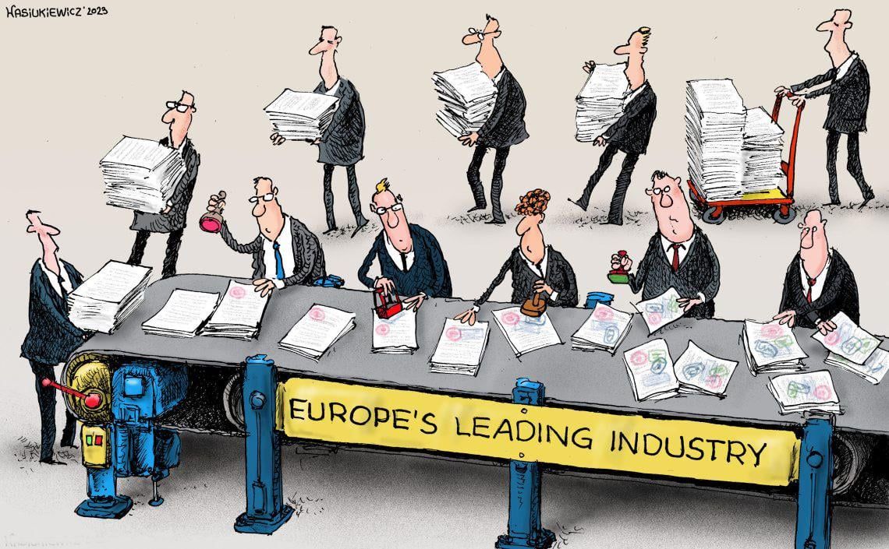
… while Europe remains obsessed with regulation

Slide 27
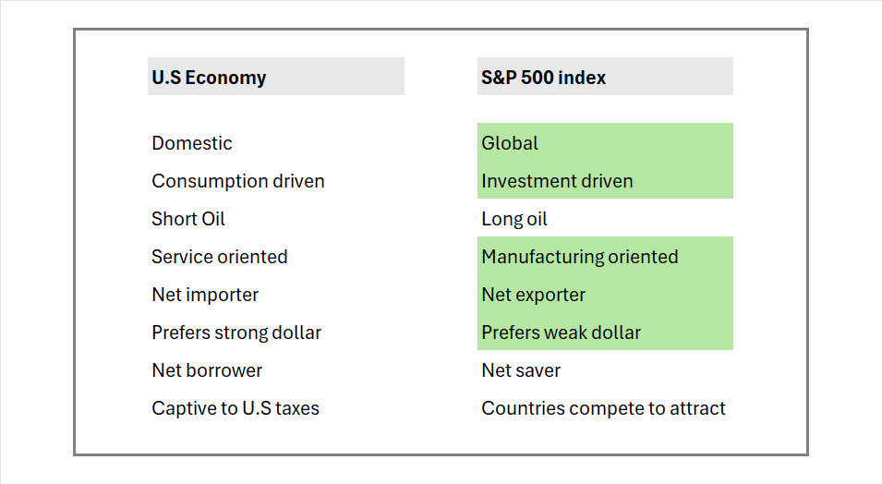
Don’t forget that the stock market is NOT the economy…

Slide 28
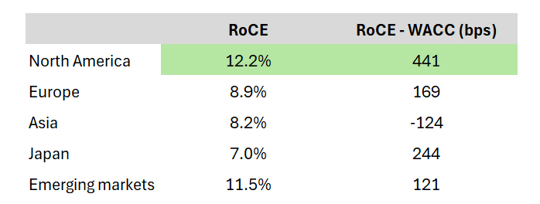
US stocks exhibit higher Return on Capital Employed (RoCE)
  Key profitability metrics excluding financials (2025) – by Redburn

Slide 29
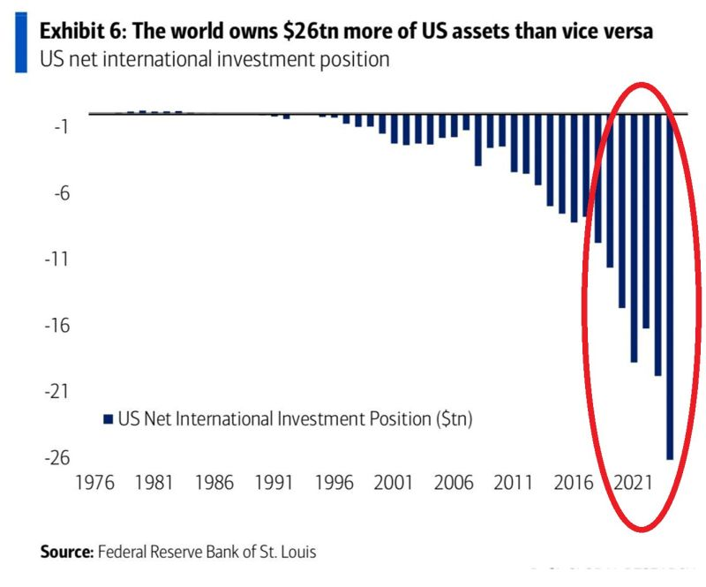
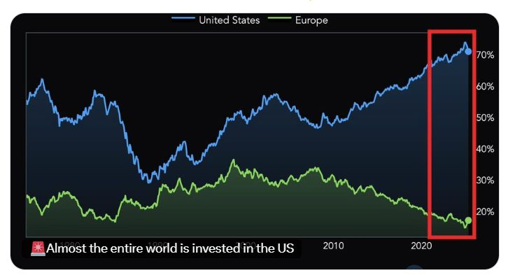
Still, there is some room for global asset allocators to rebalance
Source: Global Markets Investor, BofA

Slide 30
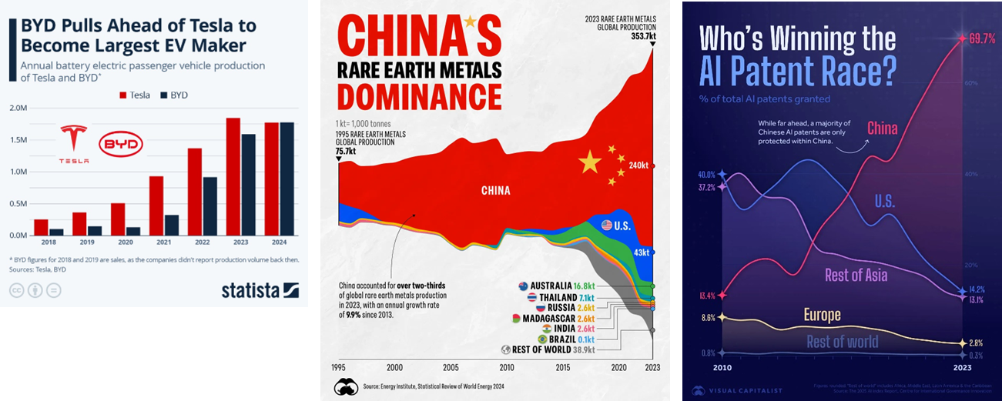
Can we afford to ignore China?

Slide 31
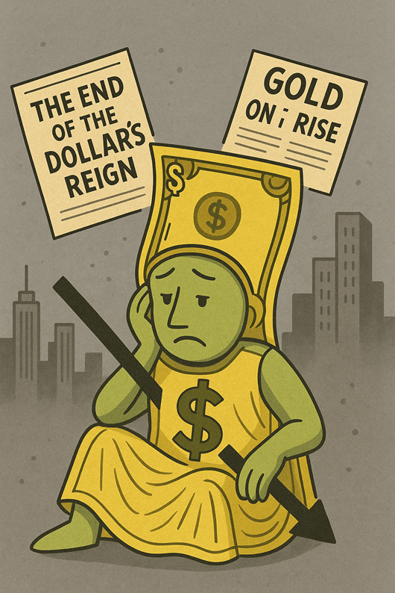
FAQ #4
Is it the end of the greenback’s reign?
Notes:
“

Slide 32
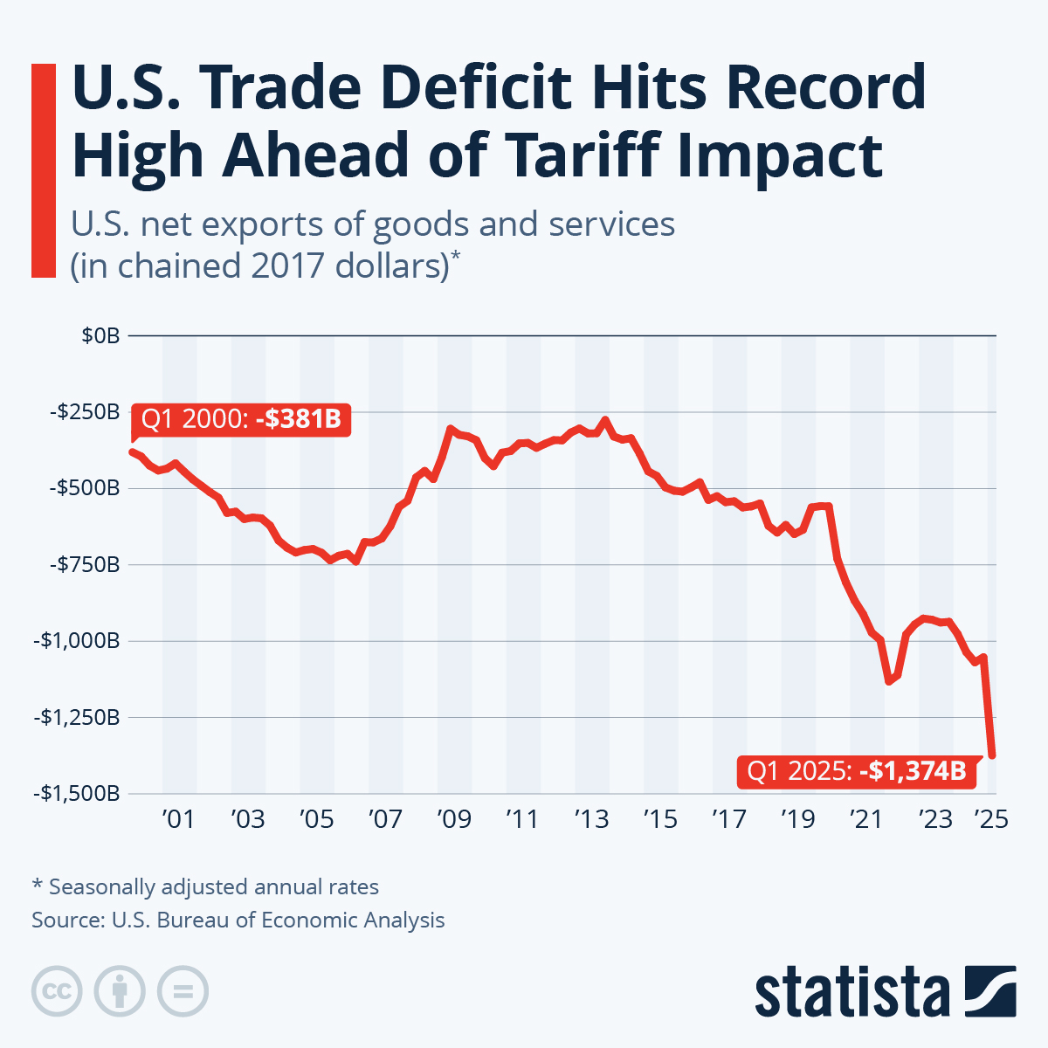
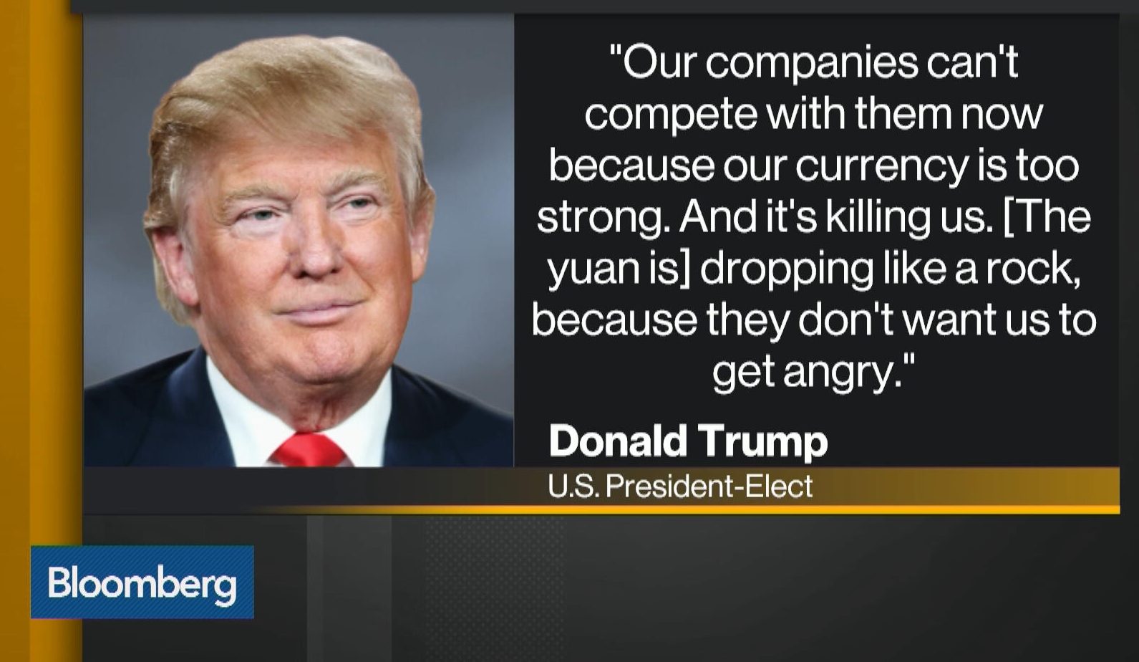
Trump believes the dollar reserve status penalises US trade balance

Slide 33
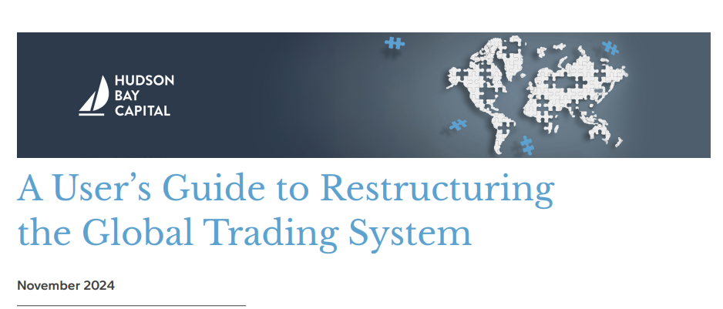
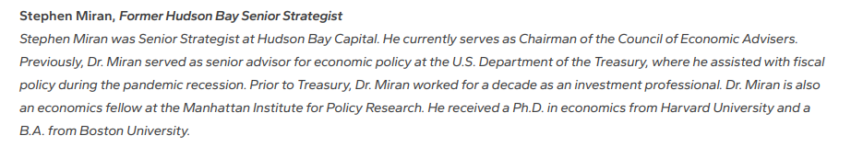
Believe it or not, there is actually a plan…

Slide 34

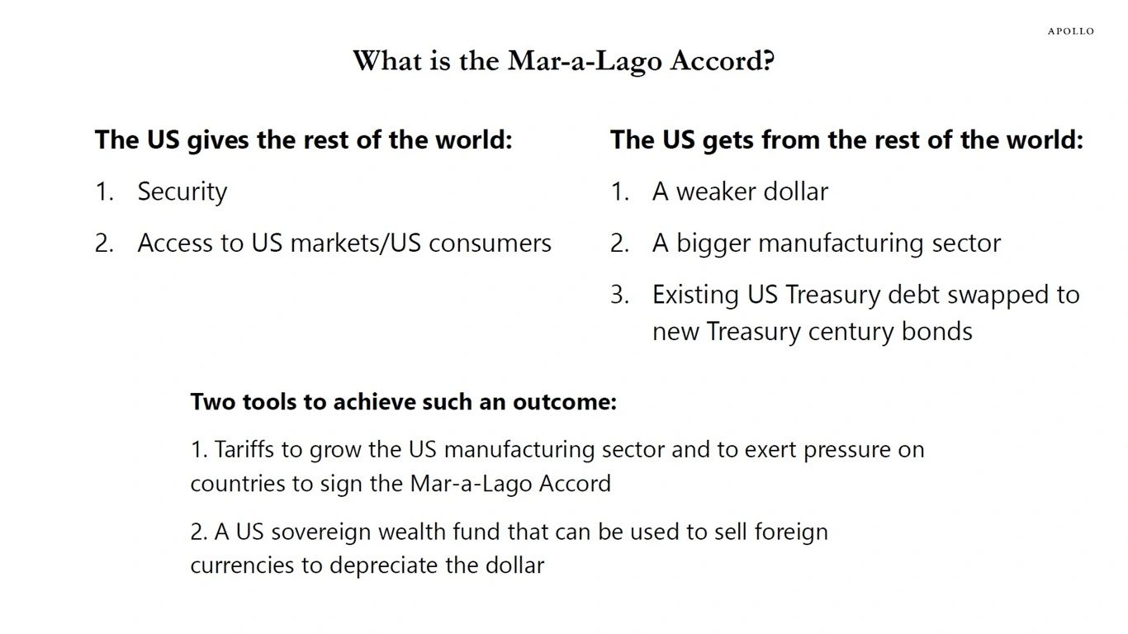
A “Mar-a-Lago accord” might be the end game
buy

Slide 35
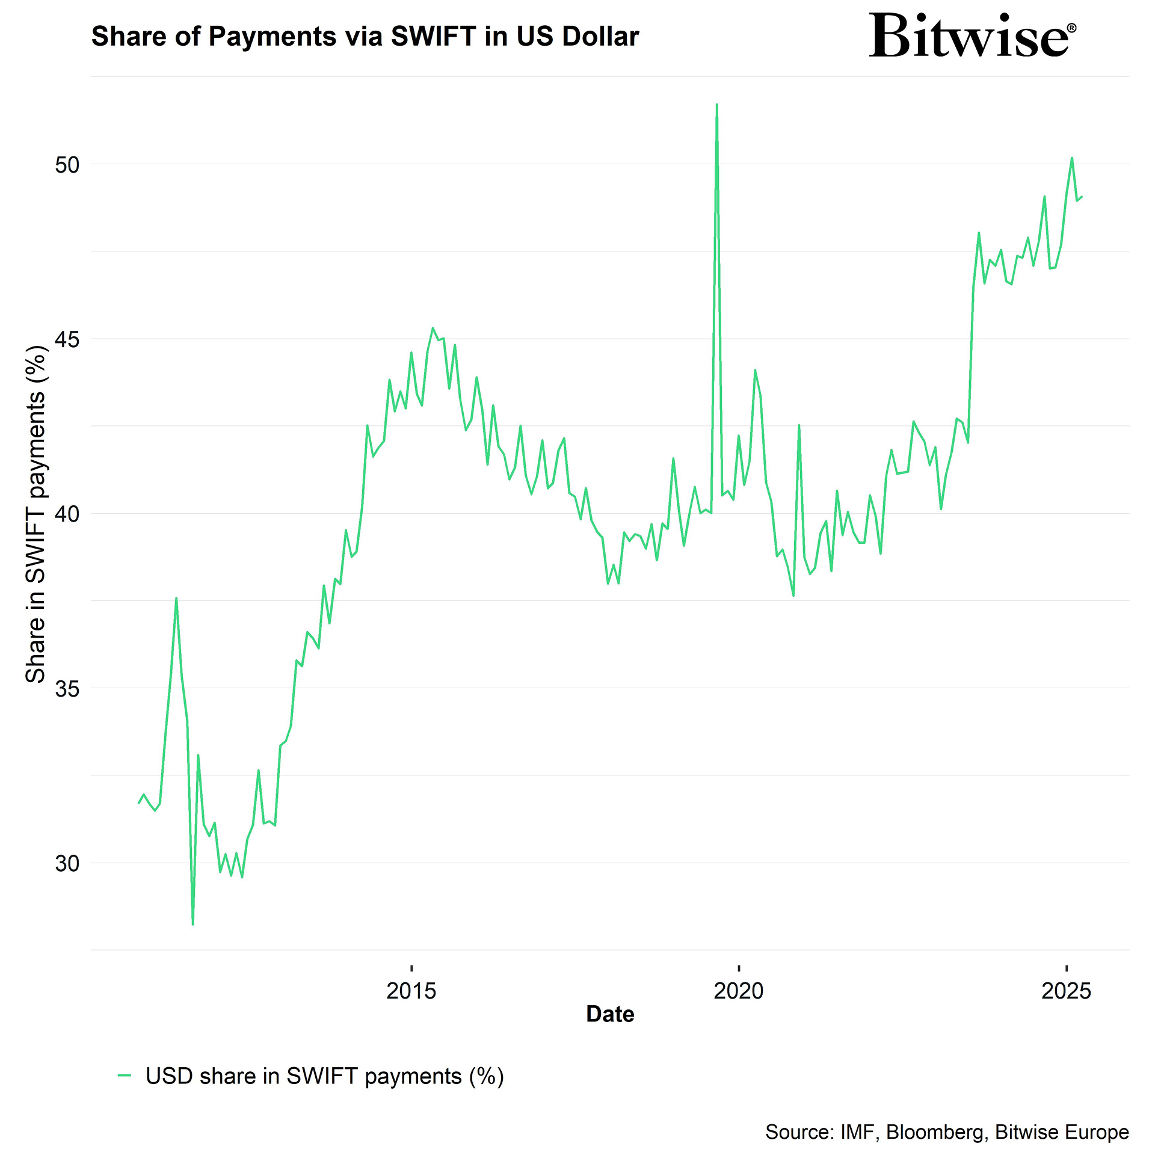
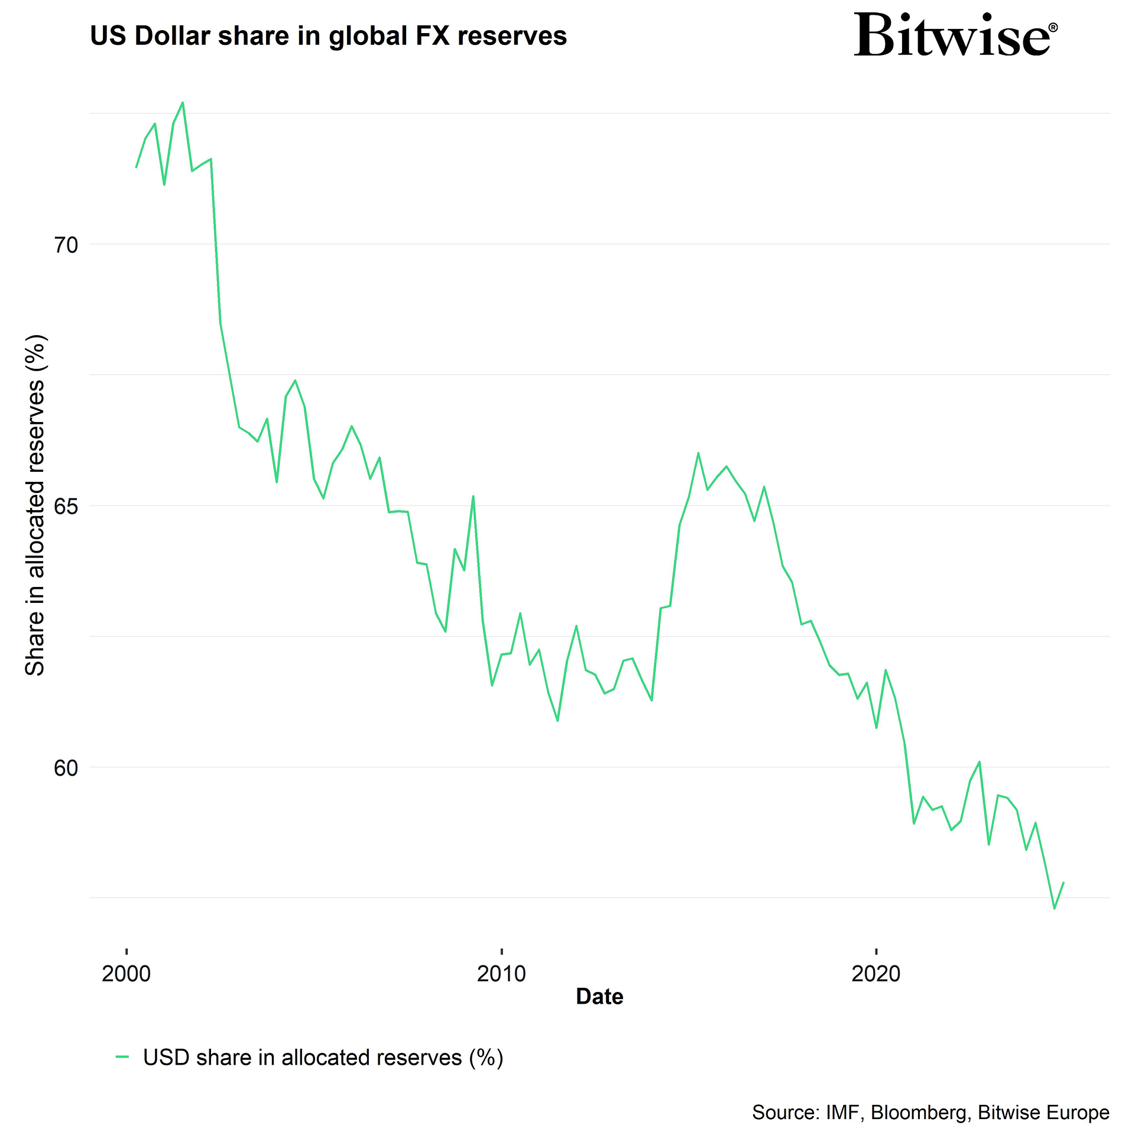
The dollar as a means of payment and less as a reserve asset
Share of payments via SWIFT in US dollar
US dollar share in global FX reserves
The future of money? Inferior money is being spent, superior money is being hoarded / saved

Slide 36
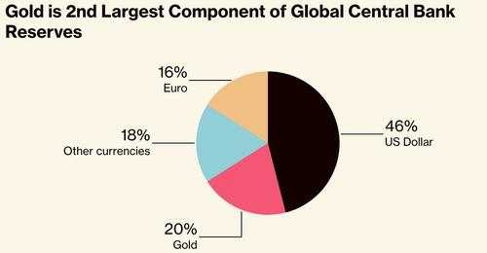
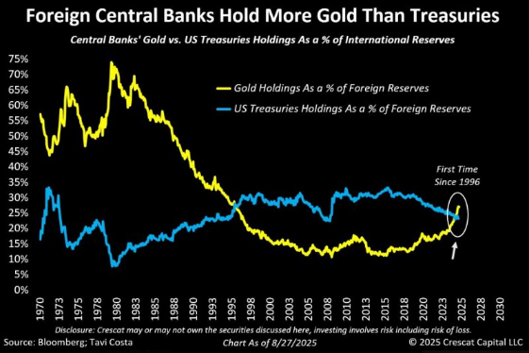
Many central banks have already started to shift their reserves

Slide 37
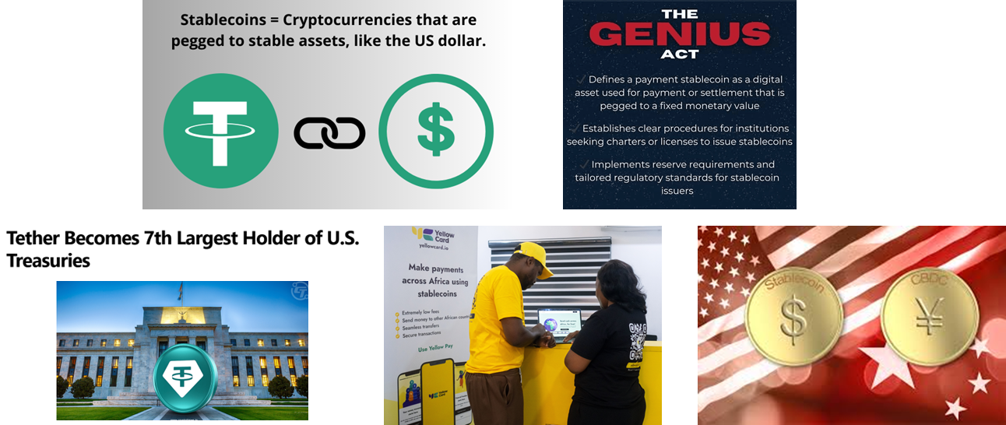
Stablecoins and the “Genius act” are part of the puzzle

Slide 38
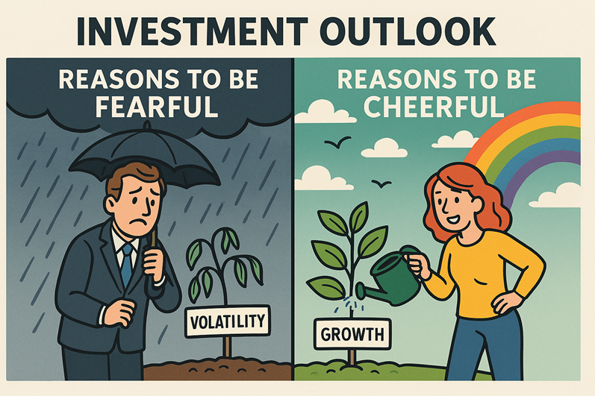
FAQ #5
How should portfolios be positioned for H2 2025 and beyond?
Notes:
“

Slide 39
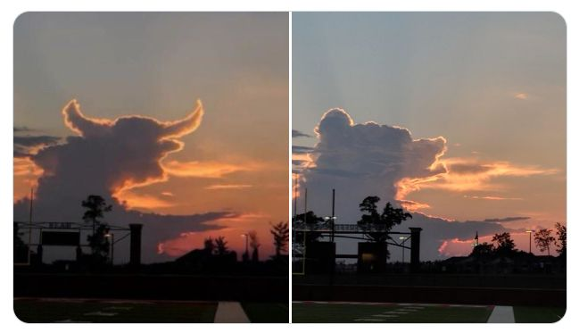
Bull versus Bear….
#markets
The bulls:
  Resilient US economy (so far)
  Strong Q2 earnings season, strong capex
  Main US equity indices at all-time highs;
  The start of a “healthy” rotation: small-caps, equal-weight, etc. are breaking out
  A global bull market (Japanese equities, Hang Seng, Korea, etc. are all breaking out)
  Fed pivot is coming + Fiscal stimulus + deregulation;
  Geopolitical situation stabilizing (Russia, tariffs, etc.)
The bears:
  US core inflation (CPI & PPI) reaccelerating;
  US consumers will soon have to absorb most of the tariffs hike
  Market too dovish on the number of Fed rate cuts?
  US Mega-caps valuations at extreme levels
  Looming sovereign debt crisis (e.g France, UK, etc.)

Slide 40

The problem with Fiat money: decay by design… so stay invested!

Slide 41

Worried about investing at all-time highs? History says you shouldn’t

Slide 42

US equities: a Summer of disbelief for institutional investors
Below is the futures positioning among asset managers and hedge funds: they sold into the hole and never got the chance to get back in. This was a textbook V-bottom, and they're still not back in. This is one of those things that can help keep a bid underneath the market.
Source: J-C Parets

Slide 43
Q4 2025 outlook
  In the US: LOWER TARIFFS, LOWER TAXES, LOWER RATES as the road map for the months to come
  Stay invested, trying to time the market is a dangerous game.
  Keep some international diversification but beware, US exceptionalism is NOT dead.
  Focus on quality, style / sector and asset classes diversification
  Watch G7 global bond markets , especially the long end of the curves

Slide 44
Looking for diversifiers...
  Equity diversifiers
  Lower AI costs to boost adoption
  Innovation beyond the Mag 7
  Global Infrastructure
  European bargains
  China “Tech-celeration”
  Selective opportunities within EM
  The “G” of “ESG”
  Liquidity diversifiers
  Hedge Funds
  Litigation Finance
  Private Equity
  Income diversifiers
  “Wealthy Nations” sovereigns
  Relative value in credit
  Structured notes
  Macro diversifiers
  Gold
  Selected commodities
  Bitcoin

Slide 45
Welcome to Syzerland

