Slide 1



Quantex Multi Asset Fund
Boring Investments return more

Slide 2
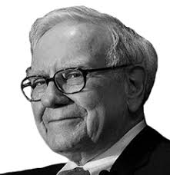
„It is not necessary to do extraordinary things to get extraordinary results.“
Warren Buffett

Slide 3
Extraordinary Results

Slide 4

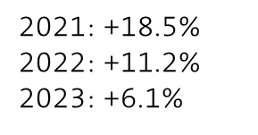
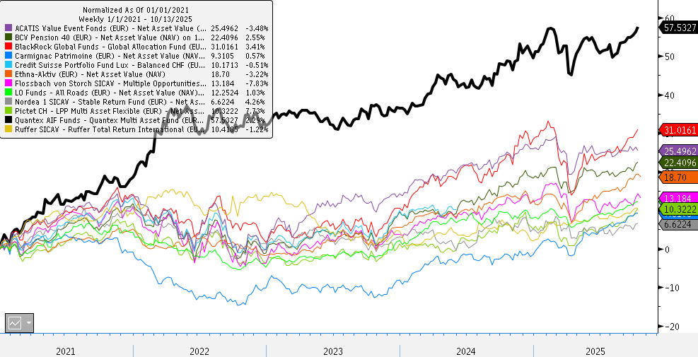
Outperformance since Inception
2024: + 10.0%
YTD: + 5.0%
Quelle: Bloomberg as of October 9, 2025

Slide 5
Reasons for our Outperformance
Boring Asset Allocation
Boring Stock Selection
Boring Commodities

Slide 6
Boring Asset Allocation

Slide 7
The Quantex Asset Allocation
Stability
Longterm Outperformance
Inflation Protection

Slide 8

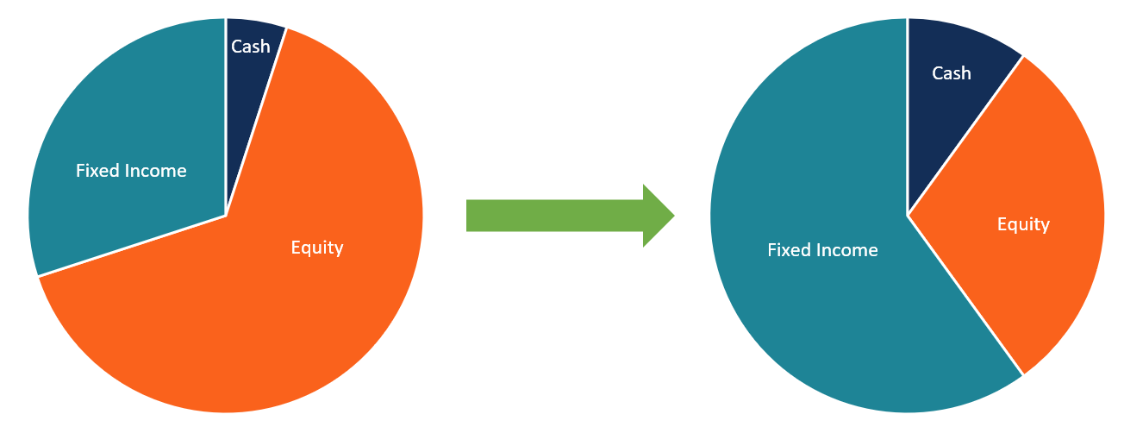
Rebalancing instead of Market Timing
Rebalancing in narrow bands vs Dynamic Allocation

Slide 9
Boring Stock Selection

Slide 10
Results – Quantex Global Value Fund
As of September 30. 2025, Inception July 18, 2008

Slide 11
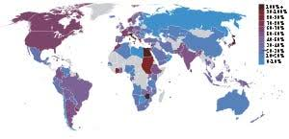


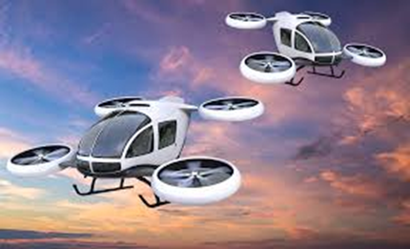

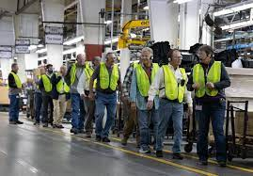

We don’t do Exciting Things
No Macro-Analysis
No Markt-Timing
No Story Stocks
No Manager Meetings
No Site Visits
No Big Bets

Slide 12

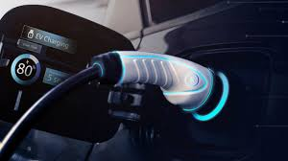




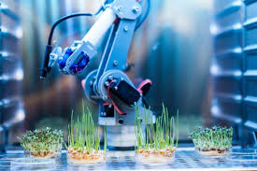



Where the others are playing

Slide 13


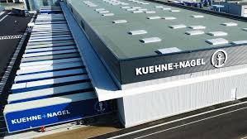

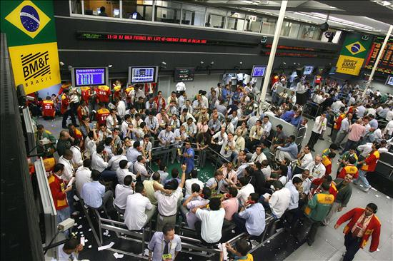
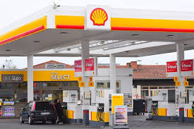
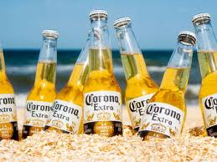

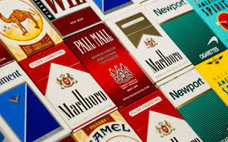
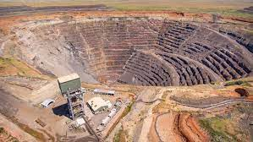
Where Quantex is investing

Slide 14
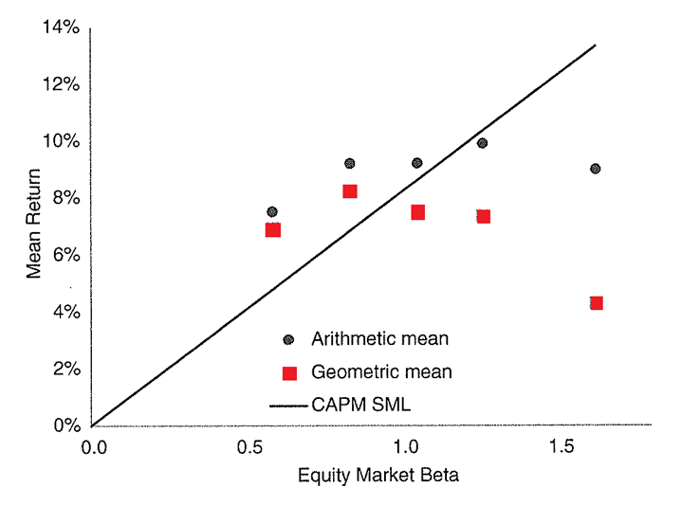
Boring Stocks perform better
Contrary to financial theory, boring low-beta-stocks outperform the more exciting stocks.
7-8% p.a. with boring stocks
4-5% p.a. with exciting stocks
Quelle:AQR/Antti Ilmanen: «Investing amid low expected returns»

Slide 15
The Current Stock Selection
We currently find value in unpopular industries such as defensive consumer goods and health care, GARP quality stocks in general, as well as in emerging markets such as Brazil and Mexico.
Value Theme | Stocks in the Quantex Multi Asset Fund
Consumer Staples | Philip Morris, BAT, AB InBev, Unilever, Reckitt Benckiser, Nestlé
Health Care | Icon, Medpace, Zoetis
GARP Quality Stocks | Booking, Visa, Mastercard, Paypal, Wise, Jumbo
Emerging Markets | Femsa, Ambev, B3, Dino Polska, Nu Holdings

Slide 16
Boring Commodities

Slide 17
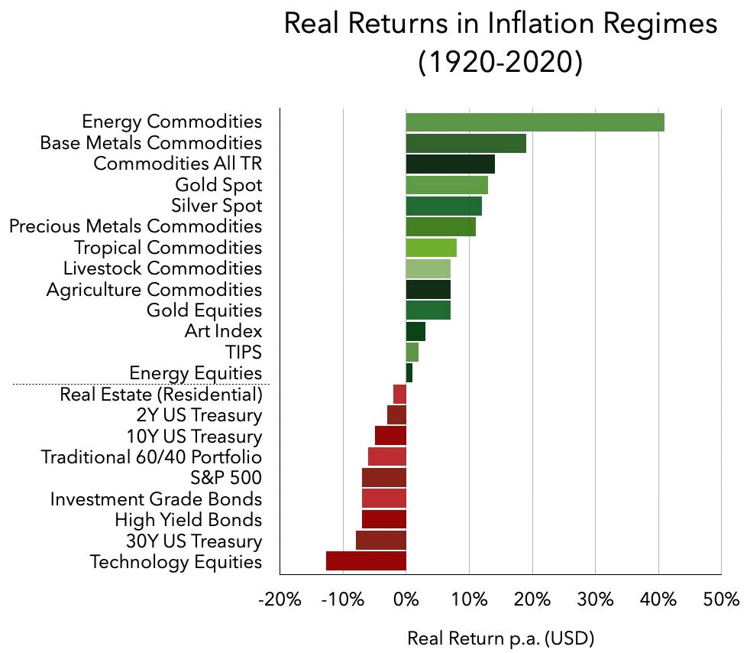
Returns during high Inflation (>5%)
Almost nobody is invested here
Everyone is overweight here
Quelle: "The Best Strategies for Inflationary Times"; Zaremba, Adam, Zaghum Umar, & Mateusz Mikutowski

Slide 18
Our Approach for Commodities
Diversified Futures-Portfolio with 14 Commodities
Fully collateralized with Cash/Money Market in USD and CHF (no Leverage)
Commodity Futures are equally weighted and regularly rebalanced – we invest passively and don´t do any research
Category | Contract
Metals | Aluminium, Copper, Silver
Soft Commodities | Cotton, Coffee, Sugar, Orange Juice, Cocoa
Grains | Wheat, Corn, Soybeans
Energy | Oil, Natural Gas, Uranium (ETF)

Slide 19
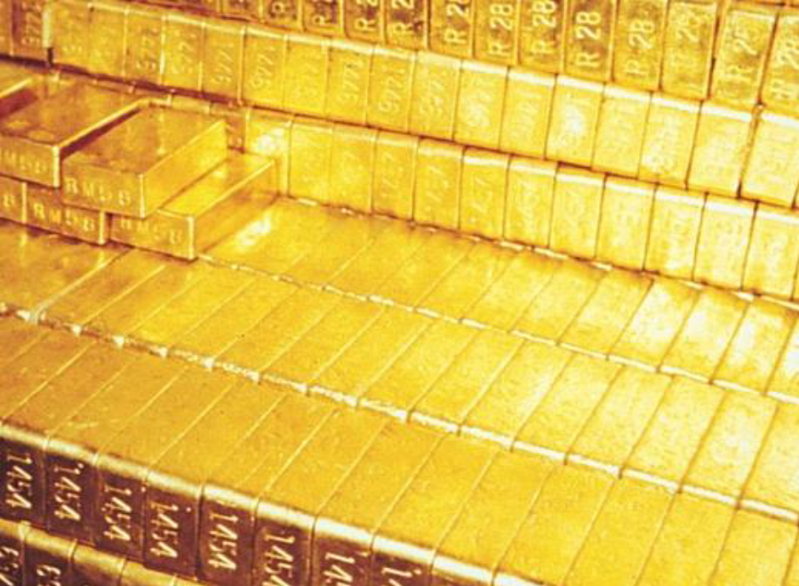
Gold Bars
Gold is a potential tail risk insurance
Physical Gold bars in a segregated account
No Derivatives and Counterparty Risks
Currently 10% of the funds assets

Slide 20
The most important Question
Are you looking for extraordinary excitement
or
extraordinary returns?

Slide 21
Appendix

Slide 22
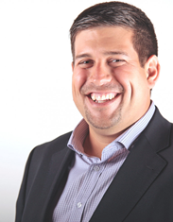
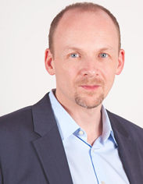
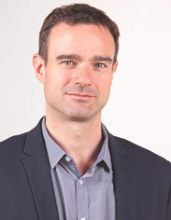
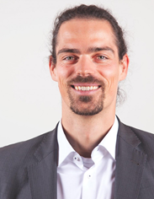
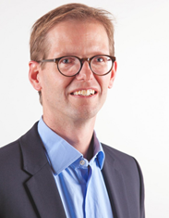
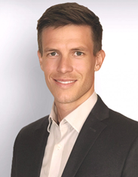
the Quantex Fund Team
Peter Zeier
Peter Frech
Since 2007 at Quantex AG
Betriebsökonom FH
CEO
Peter.zeier@quantex.ch
Since 2007 at Quantex AG
Lic. phil. Psychologie Universität Zürich
Fund Manager Global Value Fund, Multi Asset Fund und Strategic Precious Metal Fund
Peter.frech@quantex.ch
Silvio Mattanza
Livio Arpagaus
Since 2011 at Quantex AG
Lic. Iur. Universität Zürich
Risk & Compliance
Silvio.mattanza@quantex.ch
Since 2015 at Quantex AG
M.A. HSG Accounting & Finance, CIIA
Analyst
Livio.arpagaus@quantex.ch
Dr. Maurice Rüegg
Moritz Nebel
Since 2010 at Quantex AG
Dr. sc. nat. , Dipl. Ing. ETH
Spezialist IT
Maurice.rueegg@quantex.ch
Since 2020 at Quantex AG
B.A. Accounting & Finance, CIIA
Analyst
Moritz.nebel@quantex.ch

Slide 23
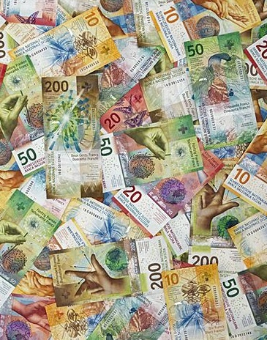
Fixed Income
We prefer cash, short duration and TIPS:
Cash (mostly Swiss Francs)
Money Market USD
Money Market EM (BRL, MXN)
Bonds (short maturities or inflation-protected TIPS)
If attractive: corporate bonds and convertible bonds

Slide 24
Fund Information
Currency | CHF/USD/EUR (accumulating)
Inception Date | December 29, 2020
Domicile | Liechtenstein
Fund Administration | LLB Fund Services AG, Vaduz
Custodian | Liechtensteinische Landesbank, Vaduz
Investment Manager | Quantex AG, Muri bei Bern
Management Fee | 1.5% S-Class / 0.75% I-Class
Subscription / Redemption | Daily, until noon by the custodian bank
Distribution Countries | Germany, Liechtenstein
GwG Status Germany | Keine GwG Pflichten für Vermittler / Berater (Bereichsausnahme GwG 1 Abs. 24 Ziff. 4)
Tax Compliance | Germany, Liechtenstein
SFDR Classification | Article 6 and 8 (light green)
AuM | 650 Mio. CHF
ISIN | CHF-Class S: LI0580516875, EUR-Class S: LI0580516883, USD-Class S: LI0580516891 CHF-Class I: LI0580516909, EUR-Class I: LI0580516917, USD-Class I: LI0580516925
WKN | CHF-Class S: A2QLGQ, EUR-Class S: A2QLGR, USD-Class S: A2QLGS
Fund platforms | Deutschland: FFB, Fondsdepotbank, Augsburger AB, Deutsche Wertpapierservicebank, Comdirect, DAB, Consors, Ebase, Comdirect, V-Bank

Slide 25
Contact and Disclaimer
.
Quantex AG
Löwenstrasse 30
CH-8001 Zürich
Tel. +41 43 243 03 46
Fax +41 43 243 03 47
Quantex AG
Marktgasse 61
CH-3011 Bern
Tel. +41 31 950 24 24
Fax +41 31 950 24 25
www.quantex.ch
This publication is a marketing information, is exclusively for informational purposes and does not constitute an offer or invitation to invest in the mentioned product. The completeness or correctness of this publication is not guaranteed. Investments can involve significant risks and the value of an investment may go down as well as up. Past performance is not indicative of future results. Units of investment funds mentioned in this publication may not be offered, sold or delivered in certain jurisdictions or to persons affiliated with certain jurisdictions. Neither this document nor any copy thereof may be sent, taken into or distributed in the United States or to any US person (within the meaning of Regulation S under the US Securities Act of 1933, as amended). The performance shown does not take account of any commissions and costs charged when subscribing and redeeming units. Fixed income securities may be classified as liquidity or as collateral for derivatives. Investments in this product occur exclusively based on the following documents: Fiduciary contract including fund-specific appendices, key information document or PRIIP-KID as well as annual and semi-annual reports. They are available free of charge at https://quotes.llb.li, at LLB Fund Services AG, Aeulestrasse 80, P.O. Box 1238, FL-9490 Vaduz, or at the German information agent/representative/paying agent Marcard, Stein & Co Aktiengesellschaft, Ballindamm 36, 20095 Hamburg, or at the German distribution agent Deutsche Finance Capital GmbH, Leopoldstrasse 156, 80804 München. In Switzerland and Austria, this publication may only be used towards qualified or professional investors. In Germany, this publication may only be used towards private individuals by persons authorized to do so. In all other cases, this publication may only be used towards professional investors and suitable counterparties within the meaning of EU Directive 2014/65/EU (MiFID II).

